Slide 1

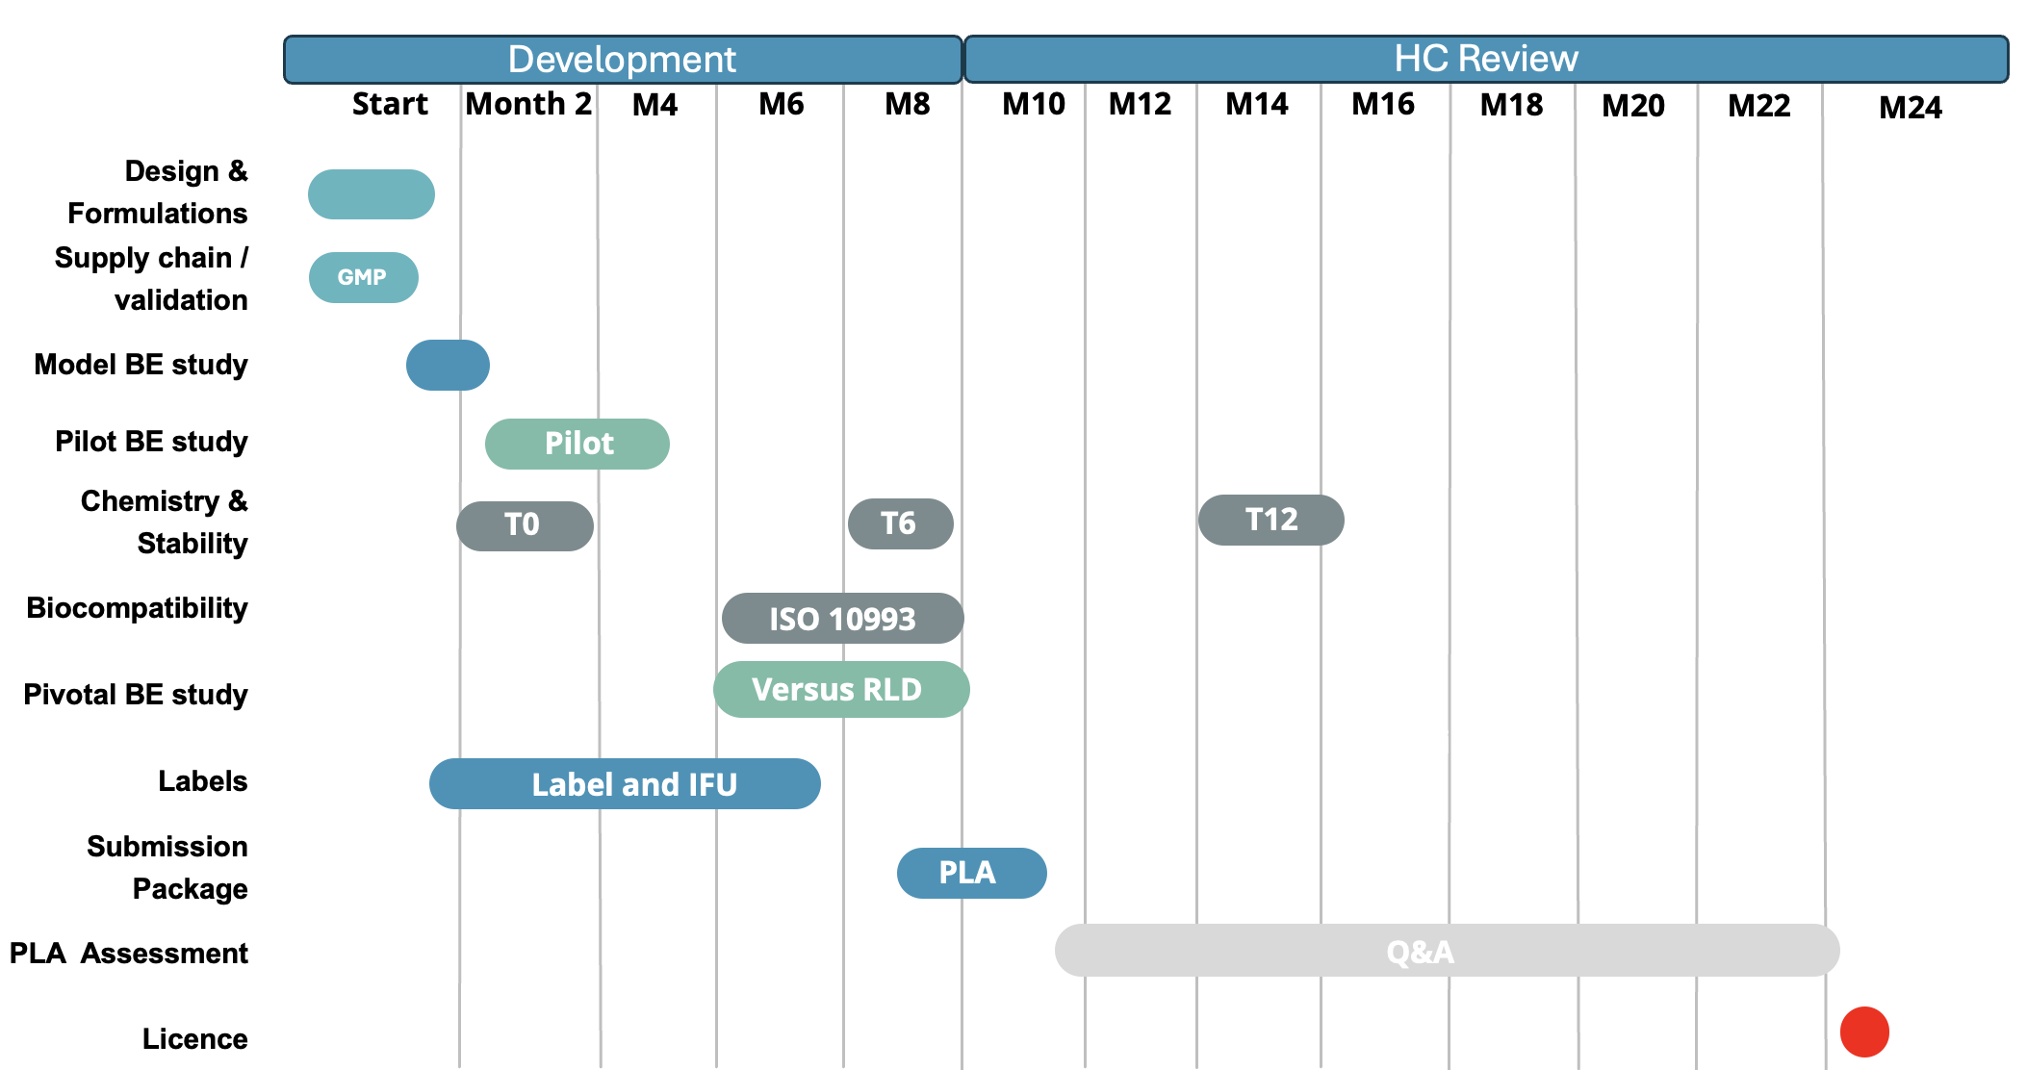
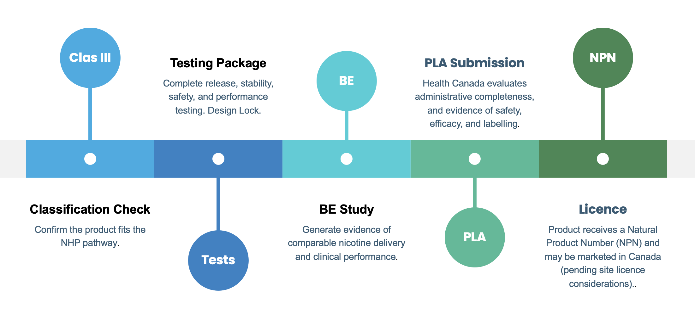
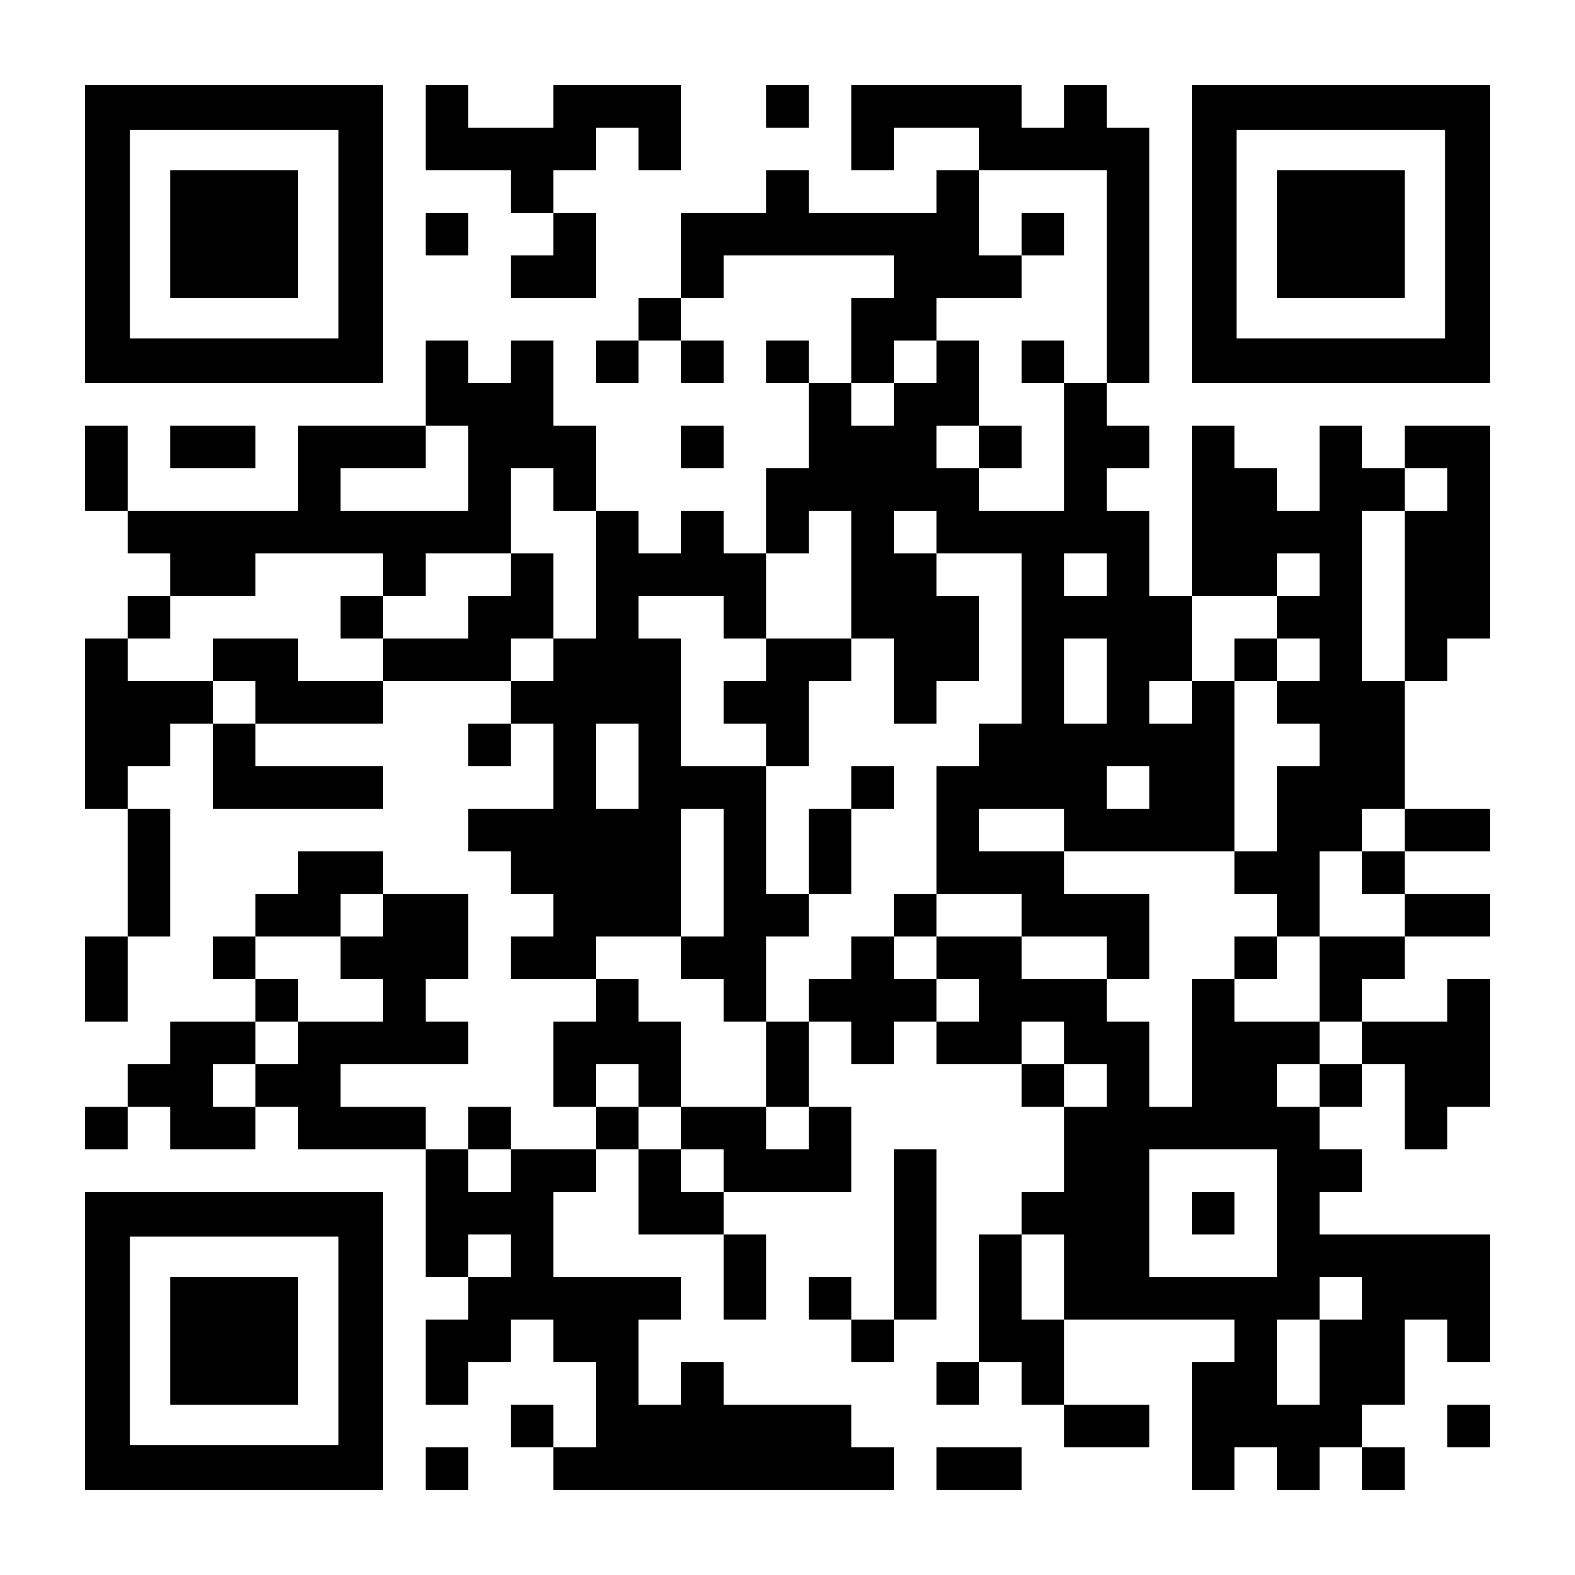
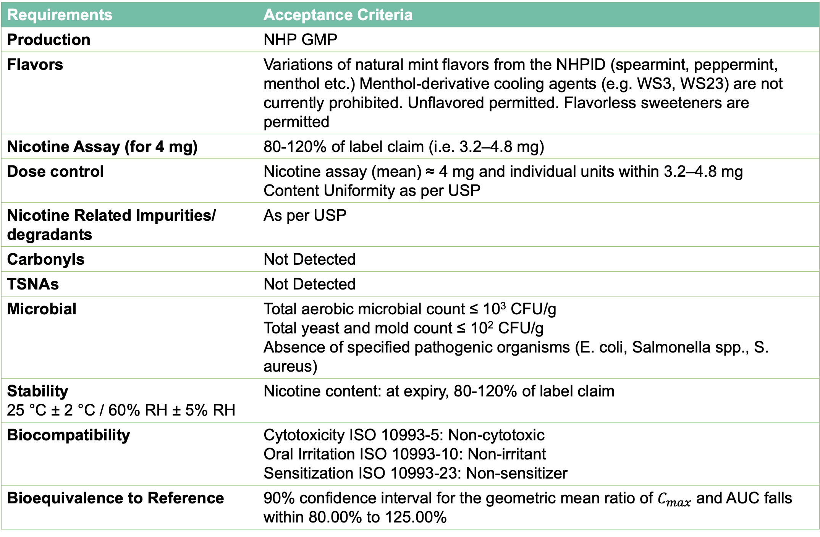
92
FROM CONCEPT TO COMPLIANCE: NAVIGATING THE REGULATORY PATHWAY FOR ORAL NICOTINE POUCHES
TO BE LICENSED AS NICOTINE REPLACEMENT THERAPY IN CANADA
Lise FRAISSINET¹, Jon-Paul Powers², Ed Carmines¹, Manoj Misra¹, Jenelle Patterson², and Alan Scott¹
¹Chemular, Inc., Hudson, MI, USA, ²Gowling WLG (Canada) LLP, Ottawa, ON, Canada
ABSTRACT
DEVELOPMENT PATHWAY
In Canada, nicotine pouches containing 4 mg nicotine or less per dosage unit are considered Nicotine Replacement Therapy (NRT) Natural Health Products (NHPs); pre-market authorization from Health Canada is required for legal sale. Product quality, safety and efficacy must be demonstrated to Health Canada via a class III product licence application (PLA). Product safety and efficacy must either be supported by a long-term cessation study or Bioequivalence (BE) to a Reference Product (a licensed NHP supported by a long-term cessation study). Health Canada has also recently implemented NRT-specific restrictions on product flavor, labelling, and marketing. Chemular and Gowling teams have combined their know-how on multiple applications, leveraging on Chemular’s product development and testing knowledge plus Gowling’s scientific, legal and regulatory expertise. This poster presents an optimized pathway to ensure a time-efficient development and tests strategy in line with Health Canada requirements and review approach.
REGULATORY FRAMEWORK
A nicotine pouch containing 4 mg nicotine per dosage unit or less falls within the NHP pathway in Canada.
The product must be positioned for smoking cessation and not for recreational use.
The product can only contain mint or menthol-derived flavors.
The flavor name on the label can only refer to mint or menthol.
All ingredients must be registered in the Natural Health Products Ingredients Database (NHPID).
The product must demonstrate Bioequivalence to a Reference Listed Drug Product (RLD) or be supported by a product-specific cessation study.
Labelling, packaging, and marketing must comply with Health Canada’s NHP Regulations and related Guidance, in addition to NRT-specific flavor and representation restrictions.
PRODUCT DEVELOPMENT REQUIREMENTS
Requirements | Acceptance Criteria
Production | NHP GMP
Flavors | Variations of natural mint flavors from the NHPID (spearmint, peppermint, menthol etc.) Menthol-derivative cooling agents (e.g. WS3, WS23) are not currently prohibited. Unflavored permitted. Flavorless sweeteners are permitted
Nicotine Assay (for 4 mg) | 80-120% of label claim (i.e. 3.2–4.8 mg)
Dose control | Nicotine assay (mean) ≈ 4 mg and individual units within 3.2–4.8 mg Content Uniformity as per USP
Nicotine Related Impurities/ degradants | As per USP
Carbonyls | Not Detected
TSNAs | Not Detected
Microbial | Total aerobic microbial count ≤ 10³ CFU/g Total yeast and mold count ≤ 10² CFU/g Absence of specified pathogenic organisms (E. coli, Salmonella spp., S. aureus)
Stability 25 °C ± 2 °C / 60% RH ± 5% RH | Nicotine content: at expiry, 80-120% of label claim
Biocompatibility | Cytotoxicity ISO 10993-5: Non-cytotoxic Oral Irritation ISO 10993-10: Non-irritant Sensitization ISO 10993-23: Non-sensitizer
Bioequivalence to Reference | 90% confidence interval for the geometric mean ratio of $C_{max}$ and AUC falls within 80.00% to 125.00%
CHEMULAR BE STUDY DESIGN
DURATION
Must align with Health Canada Guidance (based on ICH M13A) - Key Points:
CRO with NRT experience.
Output from Chemular’s PK modeling tool based on nicotine form, pH and formulation.
Number of subjects sufficient for statistical powering (minimum 12 based on ICH M13A, Chemular recommends 36 or as per calculated model from pilot study results).
Conditions consistent with product’s intended directions of use (e.g. duration, placement).
Comparison to Reference Product or international equivalent (e.g. nicotine gum or lozenge).
Regular cigarette smokers (familiar or unfamiliar with oral pouches).
Nicotine samples: 0, 0.25, 0.5, 0.75, 1, 1.5, 2, 3, 4 hours and up to 12 hours..
STEPS | ESTIMATED DURATION | NOTES
HEALTH CANADA SCREENING | 30 DAYS | Administrative completeness check
HEALTH CANADA SCIENTIFIC REVIEW | >180 DAYS | Target assessment period for PLA files submitted. Q&As.
NPN ISSUANCE AND LABEL/LAUNCH READINESS | varies | Final label implementation, commercial release and distributions set-up
REGULATORY SUBMISSION
File a Product Licence Application (PLA) through the Natural Health Products system.
Include the proposed graphic labels and Instructions For Use (IFU).
Include the BE or cessation study report for the claim and product type.
Ensure the intended use, dosage, warnings, and adult-only positioning are consistent with NHP requirements across all documents.
Additional mint flavors can be supported by a single BE study. Additional variants may be supportable through BE/bridging where formulation differences do not affect nicotine delivery
The Product Licence Application is independent from site licensing requirements. Product must be manufactured, packaged and labelled at GMP facilities. If a foreign site is used, a Health Canada-licensed importer is needed to ensure GMP compliance and facilitate import.
SUBMISSION PROCESS OVERVIEW
CONCLUSIONS
The critical aspects to ensure successful licensing are therefore:
Formulation: 4 mg nicotine; mint-menthol or unflavored only
Bioequivalence to a Health Canada-licensed Reference Product or product specific cessation study
GMP manufacturing, labelling and packaging facilities (and importer, if applicable)
Additional items that come into play:
Biocompatibility
Stability (initial shelf life must be based on data and confirmed by real time studies)
Labelling and marketing
REFERENCES
Scan here for a copy of the poster or more information
https://webprod.hc-sc.gc.ca/nhpid-bdipsn/
https://www.canada.ca/en/health-canada/news/2024/08/health-canada-introduces-new-measures-to-help-prevent-harms-to-youth-from-nicotine-replacement-therapies.html
https://www.canada.ca/en/health-canada/services/drugs-health-products/drug-products/prescription-drug-list/notices-changes/revisions-nicotine-buccal-pouches.html
https://www.canada.ca/en/health-canada/services/drugs-health-products/natural-non-prescription/legislation-guidelines/guidance-documents/supplementary-rules-respecting-nicotine-replacement-therapies-order/prohibition-application-requirements.html
https://www.canada.ca/en/health-canada/services/drugs-health-products/natural-non-prescription/applications-submissions/site-licensing.html
79th TSRC Conference 2026, Charlotte, NC, USA

