Slide 1

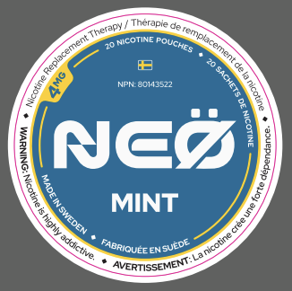
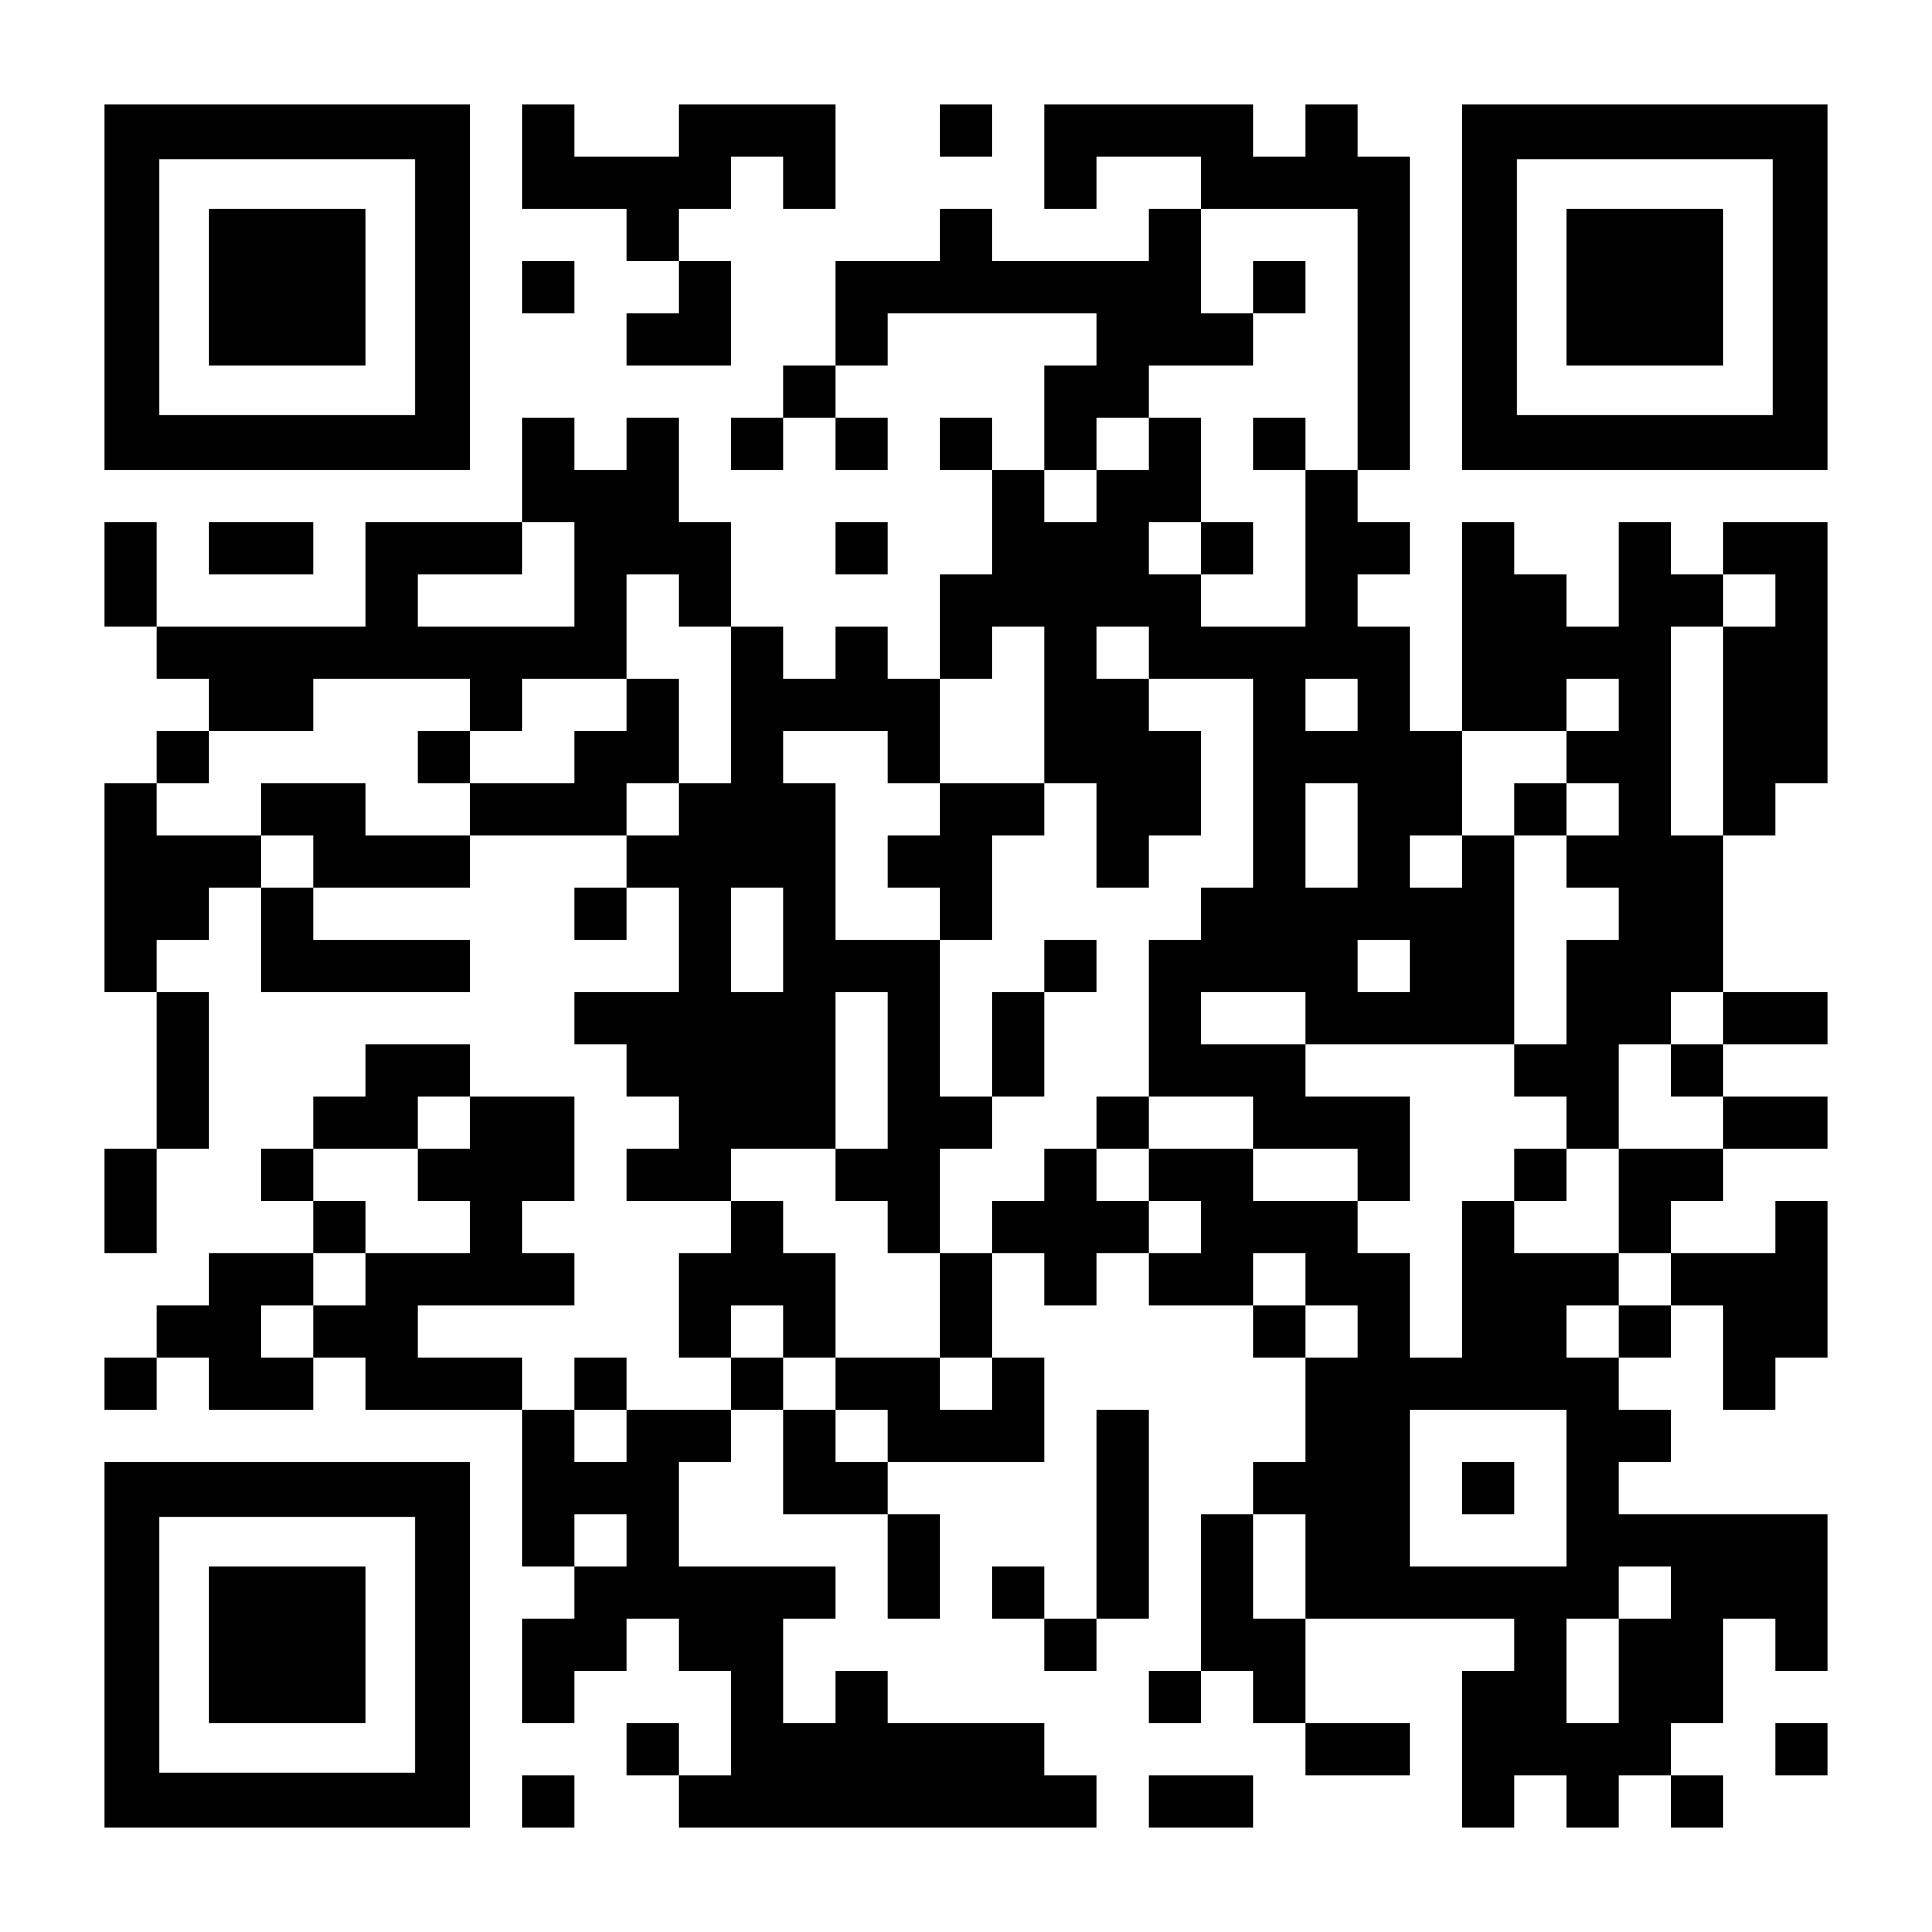
69
CANADIAN NHP BIOCOMPATIBILITY ASSESSMENT OF NEO 4 mg ORAL NICOTINE POUCH
Manoj Misra¹, Lise Fraissinet¹, Alan Scott¹, Ed Carmines¹ and Mher Manukyan²
Chemular, Inc., Hudson, USA¹; Swedish Smokeless Solutions AB, Sweden²
ABSTRACT
RESULTS
Biocompatibility testing was conducted to support the biological safety assessment of the NEO 4mg oral nicotine pouch for a Natural Health Product (NHP) product license application in Canada. Because the product is intended for repeated contact with buccal mucosal tissues, the assessment included cytotoxicity, oral mucosal irritation, and skin sensitization testing using ISO 10993-based methods.
The NEO oral 4mg nicotine pouch, manufactured by Swedish Smokeless Solution AB, was tested for cytotoxicity, buccal mucosal irritation and sensitization in product extracts following ISO 10993-5, ISO 10993-23 and ISO 10993-10 guidelines, respectively. These studies were conducted in compliance with FDA GLP regulations and OECD Principles of GLP.
The in vitro cytotoxicity study demonstrated that NEO 4mg pouch product extract was not cytotoxic in L929 mouse cell line under experimental conditions. In the oral mucosal irritation study in male Golden Syrian hamsters, the polar extract produced an irritation index score of 3, corresponding to minimal irritation, while the non-polar extract produced an irritation index score of 0, corresponding to no irritation. Under the conditions of the study, the NEO 4mg pouch was considered minimally irritating for the polar extract and non-irritating for the non-polar extract. A guinea pig maximization sensitization test was conducted to determine the potential for NEO 4mg pouch to induce skin sensitization. Based on the results of this study, the Neo pouch product was not considered to be a skin sensitizer under the conditions of the assay.
Overall, NEO 4mg oral nicotine pouch product was not cytotoxic, not sensitizer and non- to minimal-irritant following ISO 10993-5, ISO 10993-10 and ISO 10993-23 guidelines for cytotoxicity, sensitization and buccal mucosal irritation, respectively.
CYTOTOXICITY
Evaluation Criteria
Result
Grade | Reactivity | Result
0 | None | Non-cytotoxic
1 | Slight | Non-cytotoxic
2 | Mild | Non-cytotoxic
3 | Moderate | Cytotoxic
4 | Severe | Cytotoxic
Treatment | Grade | Reactivity | Result
Negative control (HDPE) | 0 | None | Non-cytotoxic
Solvent control (Cell culture medium) | 0 | None | Non-cytotoxic
Positive control (Latex examination glove) | 4 | Severe | Cytotoxic
NEO 4 mg Oral Nicotine Pouch | 0 | None | Non-cytotoxic
dermal sensitization
Evaluation Criteria
Result
Magnusson and Kligman Scale
Patch Test Reaction | Score | Result
No visible change | 0 | Non-Sensitizer
Discrete or patchy erythema | 1 | Sensitizer
Moderate and confluent erythema | 2 | Sensitizer
Intense erythema and/or swelling | 3 | Sensitizer
Treatment | Solvent | Sensitization Score |  | Result
 |  | Left Flank | Right Flank
Sham Control | Physiological Saline | 0 | 0 | Non-Sensitizer
 | Sesame Oil | 0 | 0 | Non-Sensitizer
Positive Control: DNCB | Propylene glycol | 1 | 1 | Sensitizer
NEO 4 mg Oral Nicotine Pouch | Physiological Saline | 0 | 0 | Non-Sensitizer
 | Sesame Oil | 0 | 0 | Non-Sensitizer
STUDY DESIGN AND METHODS
NEO 4 mg Product
Product Description | Target Nicotine (mg)
NEO Oral Nicotine Pouch | 4.0
oral irritation
Extract Preparation
Evaluation Criteria
Result
CYTOTOXICITY TEST
Products were extracted with cell culture media at 0.2 g/mL for 24±2 hours at 37±1°C.
SENSITIZATION TEST
Products were extracted with physiological saline and sesame oil at 0.2 g/mL for 72±2 hours at 37±1°C.
BUCCAL MUCOSAL IRRITATION TEST
Products were extracted with physiological saline and sesame oil at 0.2 g/mL for 72±2 hours at 37±1°C.
Irritation Index Criteria
Average Severity Grade | Description of Response
0 | None
1 to 4 | Minimal
5 to 8 | Mild
9 to 11 | Moderate
12 to 16 | Severe
Extraction Type | Treatment | Irritation Severity Index | Result
Polar Extraction | Solvent Control | 0 | Non-irritating
 | NEO 4 mg Oral Nicotine Pouch | 3 | Minimal irritating
Non-Polar Extraction | Solvent Control | 0 | Non-irritating
 | NEO 4 mg Oral Nicotine Pouch | 0 | Non-irritating
Biocompatibility Tests
CONCLUSIONS
Assay | Guideline | System | Compliance
In Vitro Cytotoxicity | ISO 10993-5 | Murine Fibroblast L929 Cell | ✦ U.S. FDA GLP: 21 CFR Part 58, 1978; ✦ OECD GLP: ENV/MC/CHEM(98)17
Skin Sensitization | ISO 10993-10 | Guinea pig
Buccal Mucosa Irritation | ISO 10993-23 | Hamster
CYTOTOXICITY: The NEO 4 mg oral nicotine pouch product extract is considered non-cytotoxic under the test conditions.
GUINEA PIG MAXIMIZATION SENSITIZATION TEST: NEO 4 mg oral nicotine pouch product is not considered to be a contact sensitizer under the test conditions.
BUCCAL MUCOSA IRRITATION: The oral mucosal irritation test with polar and non-polar extracts of NEO 4 mg oral nicotine pouch product in male Golden Syrian Hamsters demonstrated an irritation index score of 3 (minimal) for the polar extract and 0 (none) for the non-polar extract under the test conditions. The findings indicate a low potential for oral mucosal irritation under the conditions of the study, with no evidence of mild, moderate, or severe irritation.
In summary, Neo 4 mg oral nicotine pouch extract was non-cytotoxic in the MEM elution assay, produced minimal or no buccal mucosal irritation depending on extract type, and was not a dermal sensitizer under ISO 10993-based test conditions. These findings support the biological safety assessment of Neo 4 mg oral nicotine pouch product for repeated buccal mucosal contact in support of the Canadian NHP product license application.
Scan here for a copy of the poster or more information
REFERENCES
Magnusson, B. and Kligman, A.M. (1970). Allergic contact dermatitis in the guinea pig, Identification of Contact Allergens, Thomas, Springfield, IL..
ISO 10993-1, “Biological evaluation of medical devices – Part 1: Evaluation and testing within a risk management process.” (2023). US Department of Health and Human Services Food and Drug Administration.
ISO 10993-10:2021(E) - Biological evaluation of medical devices –Part 10: Tests for skin sensitization.
ISO 10993-12:2021(E) - Biological evaluation of medical devices –Part 12: Sample preparation and reference materials.
ISO 10993-23:2021(E) - Biological evaluation of medical devices – Part 23: Tests for irritation.
ISO 10993-5:2009/(R)2022 - Biological evaluation of medical devices – Part 5: Tests for in vitro cytotoxicity.
79th TSRC Conference 2026, Charlotte, NC, USA

