Slide 1


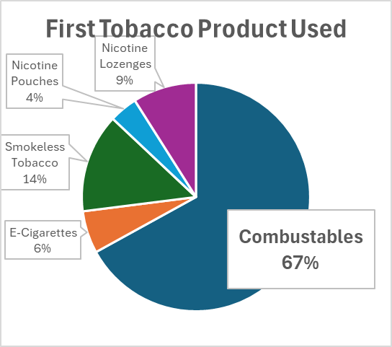
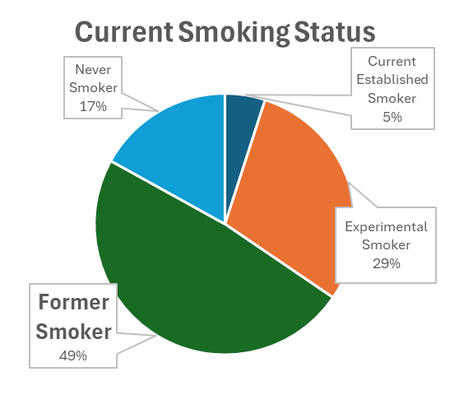
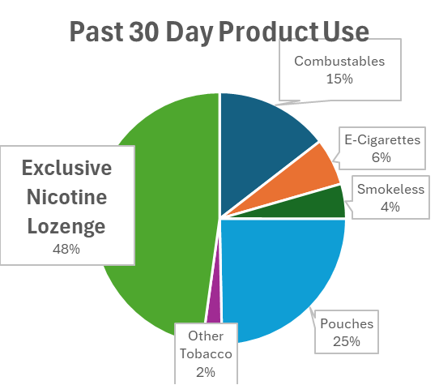
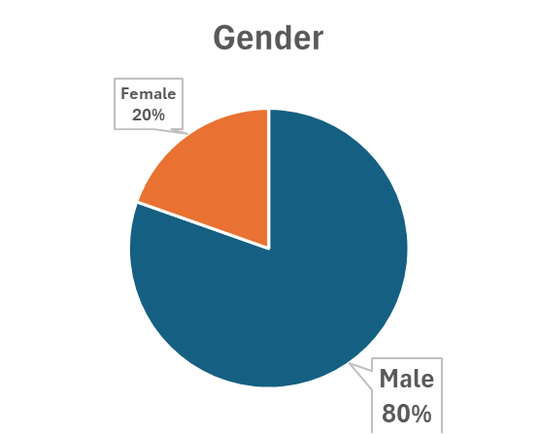
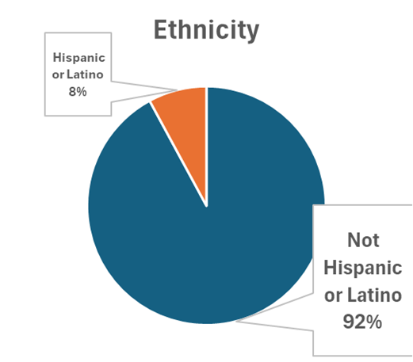
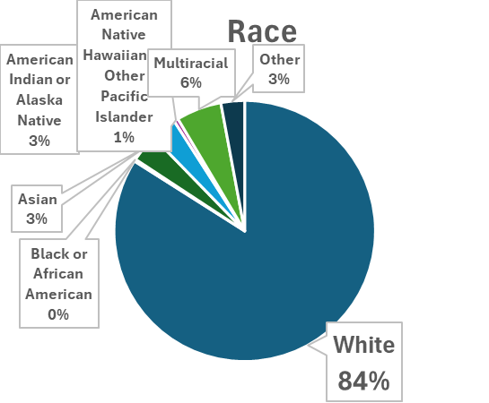
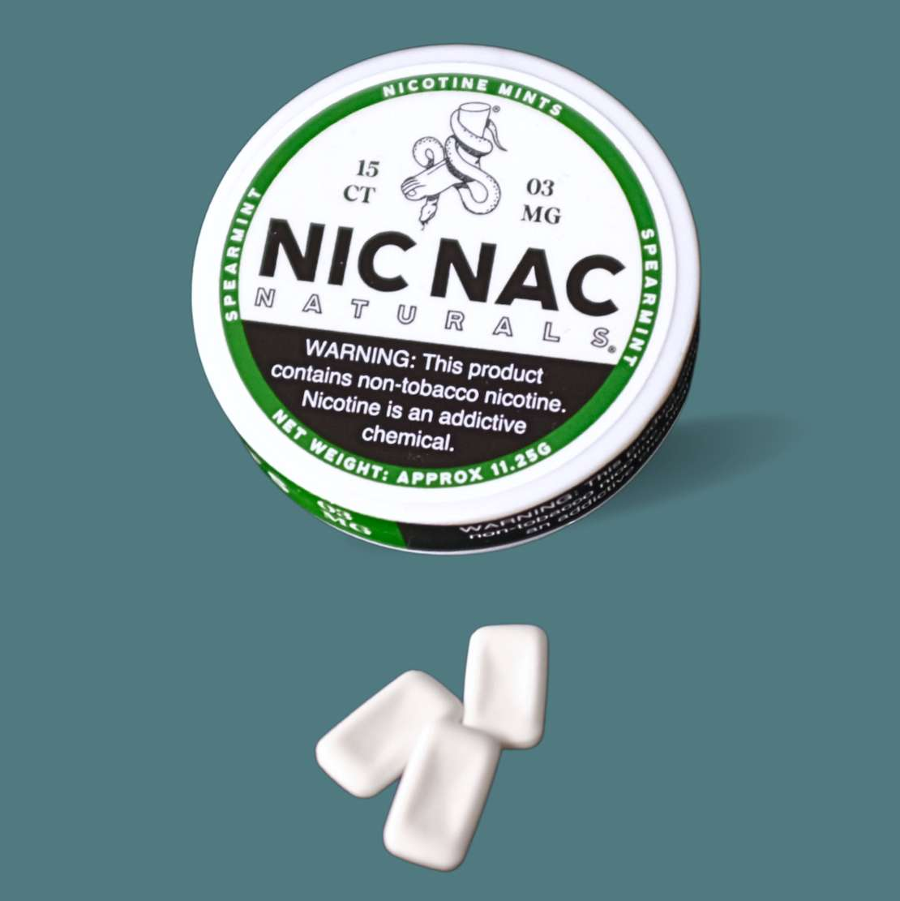
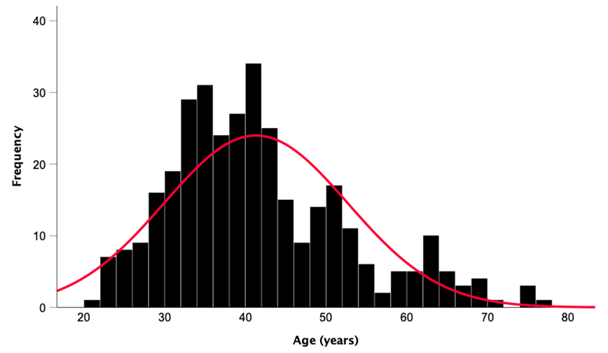
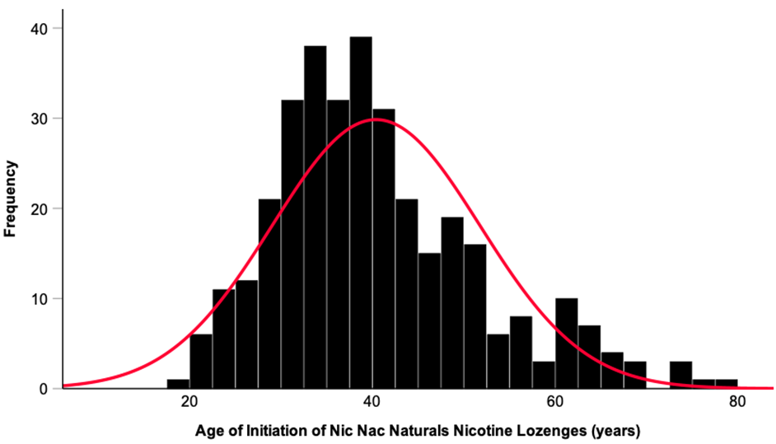
Who are the users of Nic Nac nicotine lozenges?
Ed Carmines¹ , Bryan Burd¹, Ian M. Fearon², Mary Johnson³, Sierra Thomas³, and Nicco Magnotto⁴
Affiliations: ¹Chemular, Inc, Hudson, MI, ²whatIF? Consulting, Harwell UK, ³Accelerant Research, Matthews, NC, ⁴Nic Nac Naturals, LLC, Spokane WA
Poster #88
Abstract
Methods
Results
An online survey was conducted among current users of Nic Nac nicotine lozenges to determine their demographics and use patterns. The lozenges come in multiple flavors and two nicotine strengths (3 and 6 mg), and are placed between the lip and gum, dissolving completely in less than 60 minutes. Email invitations were sent to 26,482 potential participants, resulting in 342 (1.3%) completed surveys. 79% of survey participants were male, 92% not of Hispanic Latino/Latina or Spanish origin, and 92% of white race. Participants’ mean age was 41.3 years, ranging from 21 to 80 years. Only 3.8% of users were under 25. Approximately half of survey participants were former smokers, and only 17 (5%) participants were current established smokers. 56% of participants were exclusively using the lozenges. Participants reported using the lozenges on average for 27 of the past 30 days. 75% reported using the lozenges every day. The average use was 6 lozenges per day. The predominant reason for initially buying nicotine lozenges for the first time was curiosity in trying them. Nicotine lozenge characteristics (variety of flavors available, liking the flavors, ease of use, and able to use while socializing) were also reported as reasons for first purchase. Reducing smoking-related harms was also commonly reported. Among former smoker participants, 31% reported having used Nic Nac lozenges to help them quit smoking. This study indicates that the products are not being used by youth and that the products are clearly helping participants to quit smoking or other forms of tobacco use.
This single‑wave cross‑sectional internet-based survey study assessed tobacco use history and patterns of use utilizing a convenience sample of registered purchasers of Nic Nac lozenges. The recruitment effort employed e-mails to confirmed online purchasers. Subjects were required to sign an Informed Consent Form. The following smoking status definitions, shown in Table 1, were used to define smoking status based on responses to survey questions. These definitions are based on the US Centers for Disease Control and Prevention definitions.^{[1]} The survey instrument was programmed by Accelerant Research and was hosted on the Alchemer survey platform.
Table 1. Smoking Status Definitions
Nic Nac Lozenge Usage
Parameter | Response | % | Mean
Number of days lozenges used in the past 30 days |  | . | 26.8
Use of lozenges in the past 30 days | Every day | 74% | .
 | 20-29 days | 14.90% | .
 | 10-19 days | 8.50% | .
 | 1-9 days | 2.60% | .
Number of lozenges used each day |  | . | 5.93
Status | Definition
Current Established Smoker | Smoked at least 100 cigarettes in their lifetime and in the last 30 days smoked every day or some days.
Experimental Smoker | Less than 100 lifetime cigarettes smoked.
Former Smoker | Smoked at least 100 cigarettes in their lifetime and either not smoked within the last 30 days or smoked in the past 30 days but now reports smoking ‘not at all’.
Never Smoker | Never smoked a cigarette, even one or two puffs.
Top Reasons for Using Nic Nac Lozenges
I was curious to try using nicotine lozenges | 45%
I believed nicotine lozenges might be less harmful to me than cigarettes | 36%
I had read good reviews of nicotine lozenges online | 33%
I like that nicotine lozenges come in a variety of flavors | 27%
Nicotine lozenges come in flavors I like | 25%
Nicotine lozenges looked easy to use | 25%
I'd like to use nicotine lozenges while socializing | 21%
I believed nicotine lozenges might be less harmful to people around me than cigarettes | 19%
Product Information
Results
Nic Nac lozenges contain synthetic nicotine, inert ingredients, and natural flavors. The products are made with FDA approved inactive drug ingredients and FDA GRAS flavors. Figure 1 shows a picture of the product and its packaging. The lozenges are available in two nicotine strengths, 3 and 6 mg, and in multiple flavors (Blood Orange, Cool, Grapefruit, Lemon, Peppermint, Spearmint, Tangerine, and Wintergreen) including a flavorless product (Classic). Nic Nac lozenges are designed to be placed under the lip until completely dissolved.
Future Quitting Intentions
Question | Response | %
Do you plan to use Nic Nac lozenges to help you quit smoking cigarettes completely? | Yes | 74
 | No | 26
Do You plan to ever quit using all tobacco and nicotine products for good? | Yes | 29
 | No | 71
Figure 1. Packaging and Image of Nic Nac Lozenge
Age Distribution
Age of Nic Nac Initiation
Conclusions
Mean = 41.3
Mean = 40.4
Nic Nac lozenges are predominantly used by older adults. Only 2% of users were under 24. The average age of users was 41.3 years. Their mean age at their point of first use of Nic Nac was 40.4. Participants reported using 6 lozenges a day on 27 of the past 30 days. 56% of the users had completely quit using any other tobacco products. Among the former smoker participants, 30.7% reported having used Nic Nac lozenges to help them quit smoking. The main combined reasons for trying the products was curiosity (45%) followed by a belief that the products were less harmful than cigarettes (36%). For current smokers, 74% plan to use Nic Nac lozenges to help them quit.
^{[1]} Centers for Disease Control and Prevention, 2017. National Health Interview Survey – Glossary. Available at https://archive.cdc.gov/www_cdc_gov/nchs/nhis/tobacco/tobacco_glossary.htm. Accessed on 24th March 2025
78th TSRC Conference 2025, Knoxville, TN

