Slide 1


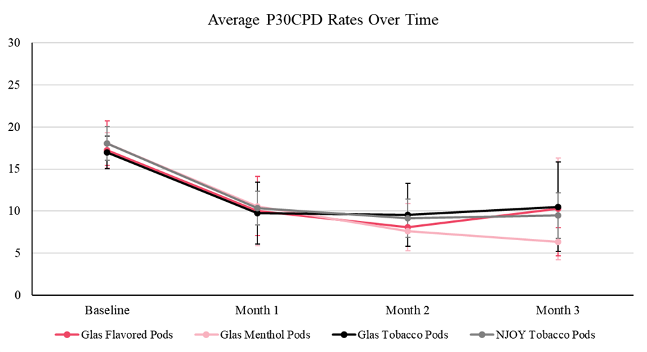
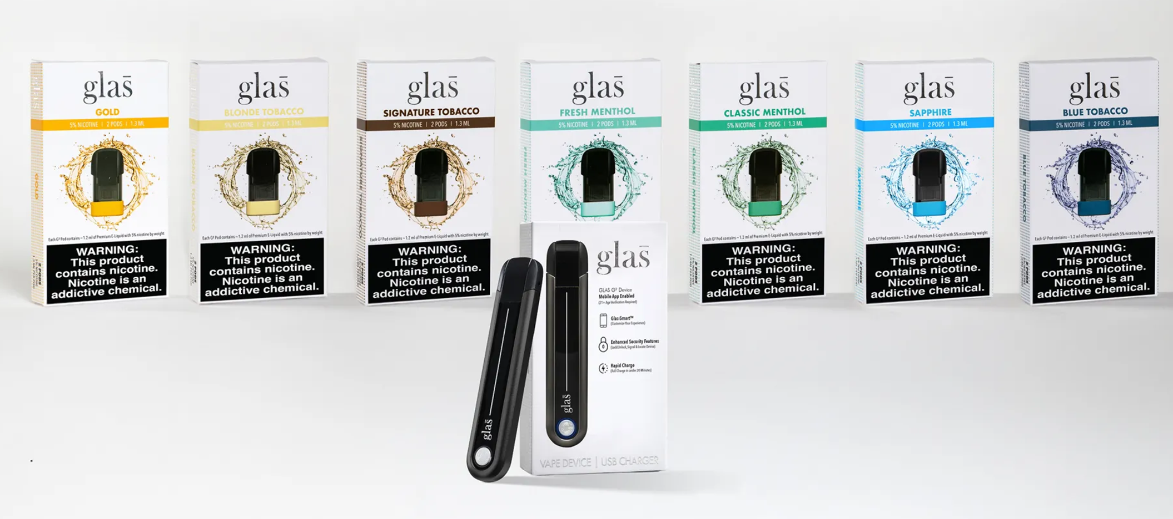
Glas age-gated pod-based ENDS facilitates tobacco use behaviors that benefit adult smokers
Ed Carmines¹, Bryan Burd¹, Kiri Stauch², Riley Wincheski², Ian Jones², Jessica Zdinak²
Affiliations: ¹Chemular Inc Hudson MI, ²ARAC Richmond, VA
Poster #88
Abstract
Methods
Results
A three-month longitudinal randomized study was conducted in 400 exclusive heavy smokers with no intent to quit. They were randomly assigned to one of four conditions, with three receiving a Glas age-gated ENDS (tobacco flavored, menthol flavored or flavors) to use for 3 months. The control condition received the FDA authorized NJOY tobacco flavored ACE. Self-report survey data were collected at baseline and each follow-up site visit (month 1, 2, and 3). The primary objective for this study was to assess the APPH benefit, specifically cessation and past 30 days CPD reduction of 50% or greater after 3 months of use under the four conditions. Results showed that for participants with any reduction from baseline (i.e., 1-49% reduction, 50-99% reduction, and cessation) the population of menthol-flavored Glas users (Odds Ratio (OR) = 3.20) are estimated to benefit the most, followed by the flavored Glas condition users (OR = 1.68) and tobacco-flavored Glas users (1.10). Use of the Glas products reduced past 30 Day CPD ≥ 50% in 45 – 46 % of the participants compared to 48% for the NJOY ACE. 13 to 21% of the Glas product users completely quit smoking after 3 months compared to 11% for the NJOY ACE. Combining all cigarette reduction (1 to 100%), 79 to 92% of the Glas users benefited whereas only 77% of the NJOY users benefited. Overall, these findings suggest that the adult smokers benefitted more from the Glas ENDS than the NJOY ACE. The Glas ENDS are age-gated, the NJOY ACE is not. Since the reduction in CPD and cessation rates after use of the Glas ENDS were essentially equivalent to the NJOY control, and the Glas ENDS are age-gated, preventing any use by underage individuals, the Glas ENDS should be viewed as substantially superior in terms of benefit to adults as compared to risk to youth.
.
Table 1. Study Primary End Point Results
A multi-site three-month longitudinal randomized experimental switching study was conducted in confirmed smokers to assess the population benefits of the Glas ENDS products. Three different Glas product conditions (Flavored, Menthol Flavored, Tobacco Flavored) were compared to the FDA-authorized NJOY ACE Tobacco Flavored products (Figure 2). FDA authorized the NJOY ACE products, concluding that they are appropriate for the protection of public health (APPH), and as such, they served as a market comparator control. Confirmed smokers (22 to 64 years of age) who smoked more than 10 cigarettes per day (400 enrolled) and who had no plans to quit but were open to trying ENDS were provided products for three months and their smoking and vaping behavior monitored through weekly and monthly surveys. The Glas Products are age-gated and the age-gating technology was enabled for the participants in all the Glas conditions.
End Point | Condition | Month 3 Percentage
% of Participants that Reduced CPD (1% to 100%) | Glas Flavored | 85%
 | Glas Menthol | 92%
 | Glas Tobacco | 79%
 | NJOY Tobacco | 77%
% of Participants in Cessation | Glas Flavored | 13%
 | Glas Menthol | 21%
 | Glas Tobacco | 21%
 | NJOY Tobacco | 11%
% of Participants Reduced CPD ≥ 50% | Glas Flavored | 45%
 | Glas Menthol | 46%
 | Glas Tobacco | 45%
 | NJOY Tobacco | 48%
% of Participants Reduced CPD < 50% | Glas Flavored | 27%
 | Glas Menthol | 24%
 | Glas Tobacco | 13%
 | NJOY Tobacco | 18%
% Reduction in Cigarette Dependence | Glas Flavored | 31%
 | Glas Menthol | 28%
 | Glas Tobacco | 30%
 | NJOY Tobacco | 23%
Figure 2. Study Design
N = 400 Exclusive Heavy Smokers
Condition 1: Flavored Glas (Gold & Sapphire)
N = 97
Condition 2: Menthol Flavored Glas (Fresh & Classic) N = 97
Condition 3: Tobacco Flavored Glas (Blue, Blonde, & Signature)
N = 95
Condition 4: NJOY Tobacco Flavored s (Classic & Rich)
N = 111
The Product and Technology
Figure 3. Study Primary End Point Results
The Glas products are a pod based vaping system (PBVS). They are rechargeable electronic nicotine delivery system (ENDS) devices. Figure 1 shows a picture of the Glas product and the different flavored pods. The ENDS is enabled with technology designed to prevent underage use and also prevent re-use or use of counterfeit E-Liquid containing pods. The pods are available in tobacco, menthol, and non-descript flavors.
Table 1 summarizes the primary end points for the study. Overall, all of the Glas conditions and the NJOY control reduced Cigarettes per Day (CPD) (Figure 3). Under all of the Glas conditions approximately 45% of the participants reduced their CPD greater than 50% by Month 3. An additional 13% to 27% reduced their CPD < 50%. The cessation rate for the Glas conditions ranged from 13% to 21%. At the end of the 3-month usage period, only 11% of the NJOY product users quit smoking completely. Combining all cigarette reduction (1 to 100%), 79 to 92% of the Glas users benefited whereas only 77% of the NJOY users benefited. Results showed that for participants with any reduction from baseline (i.e., 1-49% reduction, 50-99% reduction, and cessation), the population of menthol-flavored Glas users (Odds Ratio (OR) = 3.20) are estimated to benefit the most, followed by the flavored Glas condition users (OR = 1.68) and tobacco-flavored Glas users (1.10) (Table 2).
Figure 1. Glas Pod Based Vaping System
Conclusions
The study results demonstrate that the Glas products will have a positive public health benefit, helping smokers reduce their cigarette consumption and ultimately helping 13 to 21% of exclusive, heavy smokers, quit smoking completely in 3 months. The Glas ENDS are age-gated, the NJOY ACE is not. Since the reduction in CPD and cessation rates after use of the Glas ENDS were essentially equivalent to the NJOY control, and the Glas ENDS are age-gated, preventing any use by underage individuals, the Glas ENDS should be viewed as substantially superior in terms of benefit to adults as compared to risk to youth.
Table 2. Comparison of Overall Effects of Glas Products to NJOY
End Point | Condition | Odds Ratio
Participants that Reduced CPD (1% to 100%) AND Cessation | Glas Flavored | 1.68
 | Glas Menthol | 3.20
 | Glas Tobacco | 1.10
 | NJOY Tobacco | 1
78th TSRC Conference 2025, Knoxville, TN

