Slide 1


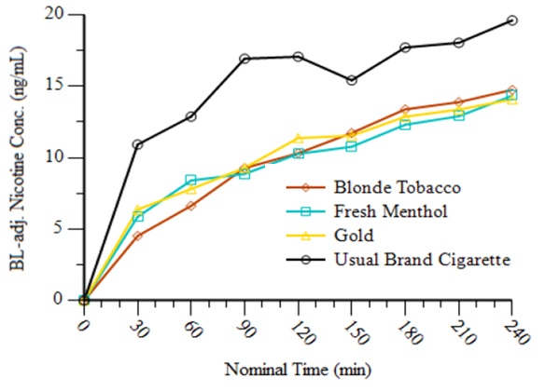
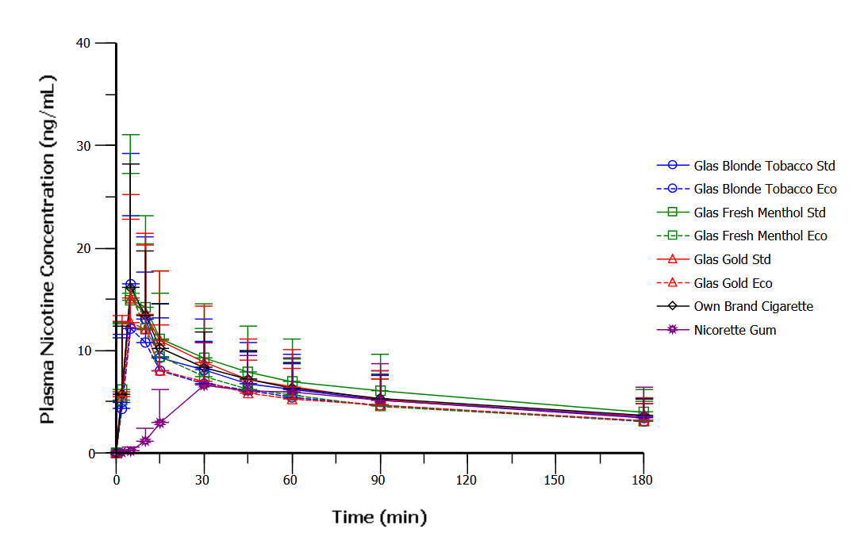
Assessment of Abuse Liability of an ENDS Under ad libitum Use Conditions
Ed Carmines¹ and Mitch Nides²
Affiliations: ¹Chemular, Inc, Hudson, MI, ²Los Angles Clinical Trials, Burbank, CA
Poster #86
Abstract
Methods
Pharmacokinetic Results
Glas has developed a pod-based ENDS device enabled with age-verification technology. The E-Cigarette is locked when purchased and the user is required to register the device and age verify before it can be activated. A human abuse liability study was conducted with the device to determine nicotine pharmacokinetics as compared to a usual brand cigarette. The subjects used the products under controlled smoking conditions and also ad libitum for 4 hours. This study showed that adults who vaped the Glas products had similar nicotine exposure during controlled use (10 puffs) when compared to usual brand cigarettes. However, during the ad libitum use, participants took more puffs of the Glas products and used them for a longer duration than cigarettes. Nicotine plasma levels were not measured during the ad libitum phase. These results suggested that smokers may achieve higher nicotine exposure during “normal” use than cigarettes and that the Glas products may have a potential higher abuse liability than cigarettes. A second study was conducted to evaluate the nicotine pharmacokinetics and topography in experienced vapers over the same 4-hour ad libitum use period. As in the previous study, the vaping topography pattern during ad libitum use was different from smoking. Experienced vapers took more, longer puffs on the Glas products than on cigarettes. These different puffs did not result in higher overall plasma nicotine levels. In fact, the plasma nicotine levels for the Glas products were consistently less than usual brand cigarettes over the four-hour extended use period. Product liking was less for the Glas products compared to cigarettes. These results indicate that the Glas products have an overall lower abuse liability than conventional cigarettes under “normal” use conditions.
This study was designed to evaluate the nicotine PK under ad libitum use conditions. Subjectives and topography were also measured. The ad libitum use session allowed the subjects to use the product as he or she might in a “real-world” scenario, with no limitation on amount of product used for up to 4 hours. This study was a part-randomized, open-label outpatient abuse liability and puffing topography study of Glas nicotine‑containing products carried out in 18 healthy adult volunteers who were experienced using ENDS and currently smoke combustible cigarettes. The Glas device was used with pods containing Blonde Tobacco, Fresh Menthol or Gold E-liquid containing 50 mg/mL nicotine. The device was set to the Standard energy setting to maximize delivery of nicotine. Subjects’ usual brand cigarettes served as the control. Subjects had to have a history of smoking an average of ≥10 cigarettes daily for at least 1 year and tested positive for urine cotinine (≥200 ng/mL) at Screening. Prior to each visit, subjects were required to refrain from using any nicotine-containing products for a period of at least 12 hours before study product use. Figure 2 shows an overview of the study design. Each product use session consisted of a 4-hour ad libitum product use. Subjects could use as much or little of the products that they desired. During each ad libitum product use session, pharmacodynamic measures were collected during and at the end of each ad libitum product use period. Blood was collected every half hour for plasma nicotine analysis. Exhaled carbon monoxide was collected before and at the end of the ad libitum session. Product use behaviors (i.e., number of cigarettes smoked and number of pods used) and topography (e.g., puff durations, puff count, puff volume, outflow of vapor/smoke, session length, and puff interval) were collected throughout each ad libitum product use session.
Figure 3 shows the plasma nicotine levels compared to the usual brand cigarette. The subjects consistently used the Glas products over the 4-hour ad libitum period resulting in lower levels of nicotine in the plasma when compared to usual brand cigarettes.
The mean plasma nicotine concentrations for all 3 study ENDS were similar to each other.
The mean nicotine AUC ₀₋₂₄₀ values among the study products were all lower than that observed for usual brand cigarettes.
Results from a repeated-measures ANOVA indicated that both the C_{max 0-240} and AUC₀₋₂₄₀ for usual brand cigarettes were statistically greater from the Glas products as a group.
Figure 3. Mean Plasma Nicotine Concentration
Pharmacodynamic Results
Nicotine PK Under Controlled Use
Figure 2. Overview of Abuse Liability Study Design
All of the Glas products were liked less than usual brand cigarettes. The mean score was 72.0 for usual brand cigarettes, followed by 43.6 for Fresh Menthol, 51.6, for Blonde Tobacco and 52.8 for Gold.
Intent to use the product again was also less for the Glas products compared to usual brand cigarette. The mean score was 85.1 for usual brand cigarettes, followed by 40.2 for Fresh Menthol, 47.4, for Blonde Tobacco and 51.1 for Gold.
All of the subjects had a high urge to smoke at baseline (~80-90) . After 4 hours of use, usual brand cigarettes had reduced the urge to 30.8 (-50.9 units). Blonde Tobacco, Fresh Menthol, and Gold were only slightly reduced to 71.4, 71.1, and 64.7.
A human abuse liability study was previously conducted to determine nicotine pharmacokinetics as compared to a own brand cigarette (OBC). The subjects used the products under controlled smoking conditions and also ad libitum for 4 hours. This study showed that adults who vaped the Glas products had similar nicotine exposure during controlled use (10 puffs) when compared to OBC (Figure 1). However, during 4 hours of ad libitum use, subjects took more puffs of the new products and used them for a longer duration compared to their OBC. Nicotine exposure data were not collected during the ad libitum use period. Increased use and puff topography of the new products compared to OBC suggested that adults who smoke cigarettes may achieve higher nicotine exposure from the new products under similar use conditions. This higher nicotine exposure may contribute to a higher abuse liability, subsequent increased nicotine dependence, and addiction associated with the new products compared to OBC.
Screening
Check-in and Product Trial
Ad Libitum Use Session
BLONDE TOBACCO |  |  | 48 hr |  | FRESH MENTHOL | FRESH MENTHOL |  | 48 hr |  | GOLD | GOLD |  | 48 hr | 48 hr |  |  | USUAL BRAND CIGARETTE | Usual Brand Cigarette
End of Study/Early Termination
Topography Results
The subjects took more puffs of a longer duration with the Glas products. The subjects smoked a median of 5 cigarettes taking 92.4 puffs. The number of puffs for the Glas products ranged from 138.9 to 181.6. The inter-puff interval for smokers was only 0.39 minutes compared to about 2.5 minutes for the Glas products. The average puff volume was much larger for the Glas products (119 to 135 ml) compared to the usual brand cigarette of 47 ml. The flow rate was larger with the Glas products.
Figure 1. Baseline-Adjusted Plasma Nicotine Concentrations Under Controlled Use
Results
Conclusions
A total of 22 subjects were screened, and 18 subjects were randomized. All 18 (100%) subjects completed the study. No subjects were discontinued from the study. Subjects ranged in age from 32 to 68 years, with a mean age of 48.6 years. Most subjects were female (55.6%) and white (56.3%). All subjects were confirmed smokers as indicated by exhaled CO (> 10 ppm). Subjects smoked a mean (SD) of 14.4 (4.91) cigarettes per day (CPD) during the past 3 months with a minimum and maximum of 10 and 30 CPD, respectively . The mean (SD) of number of years smoked was 26.2 (11.51). Subjects reported vaping on average 521 days over their lifetime with a median of 321 days.
In experienced vapers, Glas products produced consistent levels of nicotine and reductions in urge to smoke over the 4-hour ad libitum use period.
Combustible cigarettes yielded statistically significantly higher peak concentrations of nicotine and higher reductions in urge to smoke.
While the number of puffs and puff volume were increased for the Glas products, there was no commensurate increase in nicotine absorption.
Mean values for product liking for the Glas products were all lower than the mean value for cigarettes.
These results indicate that risk of abuse liability is lower for Glas products during normal use than it is for the combustible cigarettes.
78th TSRC Conference 2025, Knoxville, TN

