Slide 1
Optimizing abuse liability studies for FDA review of novel nicotine products
Matthew McMurray, PhD
Ed Carmines, PhD
Chemular Inc.
matthew.mcmurray@chemular.com
ed.carmines@chemular.com

Slide 2
Abuse liability studies
Quantifying the abuse liability of oral nicotine products is challenging
Abuse liability studies should assess:
Nicotine exposure during and after product use
How people use the product (topography)
Subjective effects of use (e.g., product liking, urge to smoke)
Overnight Abstinence
Controlled Use Period
Ad Libitum Use Period
Blood draws during Controlled and Ad lib for nicotine levels
Use topography assessed during ad libitum only
Subjective effects during Controlled and Ad lib

Slide 3
Nicotine pharmacokinetics (PK)
Measure | Definition | Relationship to Abuse Liability
Cmax | Max nicotine in blood | Higher Cmax = Higher Abuse Liability
Cmax
Tmax | Time to Cmax | Lower Tmax = Higher Abuse Liability
AUC | Area under the curve (total nicotine exposure) | Higher AUC = Higher Abuse Liability
Blood Nicotine Level
AUC
Tmax
Time →

Slide 4
FDA review of abuse liability
Goldilocks Paradox: Abuse liability high enough to facilitate switching from cigarettes, but lower than a cigarette
Examples show current thinking:
Products with MGO
iQOS
General Snus
Zyn
Products with MDO
Bidi Stick
Products Pending Review
Glas
on!

Slide 5
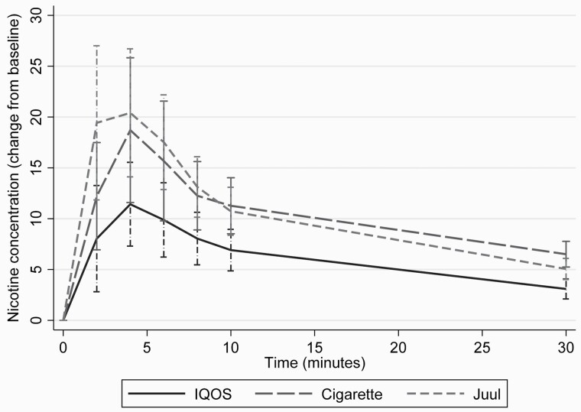
Modified risk tobacco products
iQOS
General Snus
Phillips-Waller et al, 2021
2025 TSRC Poster #102
Marketing Granted 2019 (MRTP 2020)
Lower abuse liability than cigarette
Marketing Granted 2019 (MRTP 2020)
30-min use period
Lower abuse liability than cigarette

Slide 6
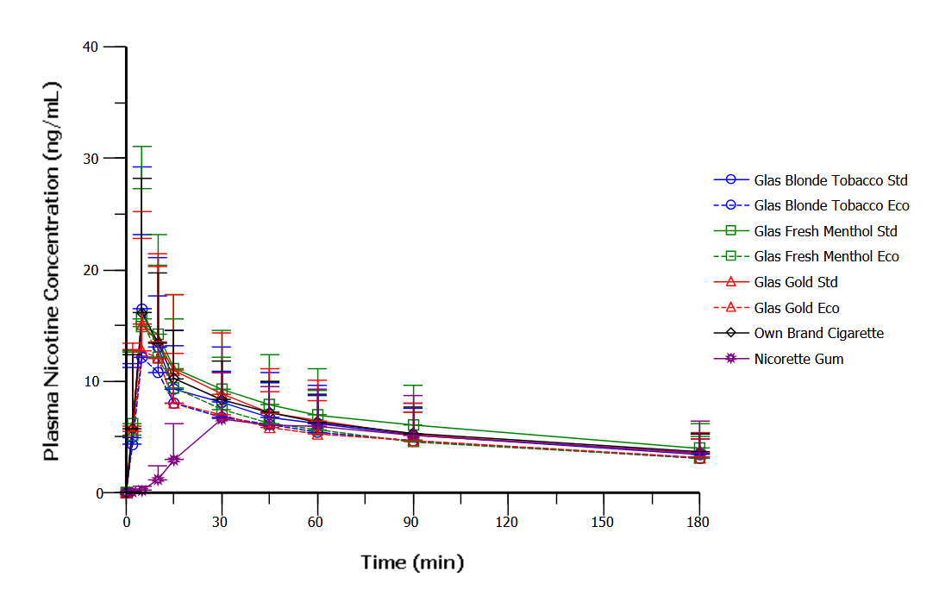
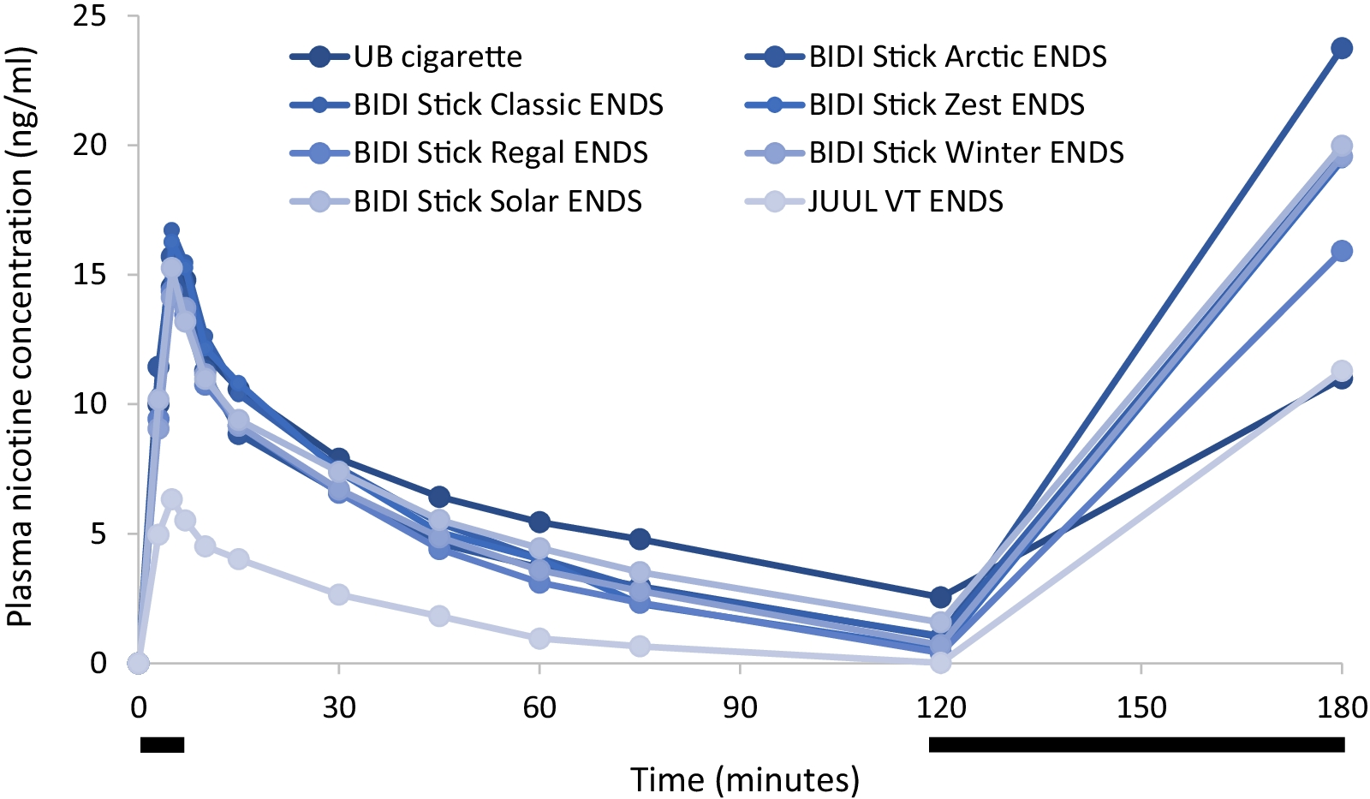
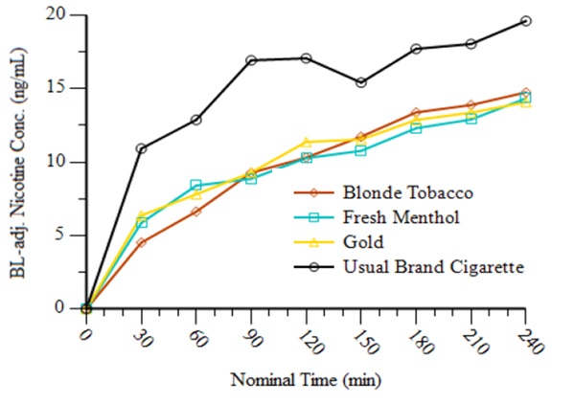
E-cigarettes
Glas
Bidi
Fearon et al., 2022
2025 TSRC Poster #86
Not yet reviewed by FDA
Likely lower abuse liability than cigarette
Marketing Denied in 2024
Higher abuse liability than cigarette

Slide 7
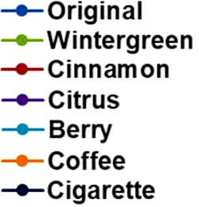
Nicotine pouches
Zyn
on!
Lunell et al., 2020
Rensch et al., 2021
Marketing Granted in 2025
60-min use duration
Comparable or lower abuse liability than snus
Not yet reviewed by FDA
30-min use duration
Likely lower abuse liability than cigarette

Slide 8
Some lessons to consider
Nicotine PK > topography > subjective effects
Ad libitum use is as important as controlled use
High abuse liability comparators needed, but not likely low
Experience of participants matters
FDA evaluates abuse liability using data from all studies (BOE, switching, actual use, survey, etc.)
Defaults to most conservative interpretation when data conflict

Slide 9
Some challenges for oral products
Can have conflicting nicotine PK information
e.g., longer Tmax, but Cmax and AUC > cigarette
Controlled vs. ad libitum
Longer use duration requires longer assessments
Controlled use: >2 hours; ad libitum: >4 hours
Affects the number of blood draws and collection times
Consider at-home use studies of urinary biomarkers
Duration of controlled use must be justified
Longer controlled use increases nicotine PK (Azzopardi et al., 2025)
But also provides benefit to smokers
Experience affects use topography
What defines experience for oral products?
Dissolution data may support bridging arguments

Slide 10
Some challenges for regulators
How to handle conflicting abuse liability results
Tmax vs Cmax vs AUC
Subjective effects vs nicotine exposure
Controlled use vs ad libitum use
How to weigh risks & benefits to adults that smoke
Unlikely that FDA will allow oral products with abuse liabilities exceeding a cigarette (Mallock-Ohnesorg et al., 2024)
How to consider non-tobacco flavors
Unknown effect of flavor for modern oral products
Youth appeal of modern oral products is currently low

Slide 11
Thank you!

Slide 12
References
Phillips-Waller A, Przulj D, Pesola F, Smith KM, Hajek P (2021) Nicotine Delivery and User Ratings of IQOS Heated Tobacco System Compared With Cigarettes, Juul, and Refillable E-Cigarettes. Nicotine Tob Res 23(11):1889-1894. doi: 10.1093/ntr/ntab094.
Fearon IM, Gilligan K, Seltzer RGN, McKinney W (2022) A randomised, crossover, clinical study to assess nicotine pharmacokinetics and subjective effects of the BIDI® stick ENDS compared with combustible cigarettes and a comparator ENDS in adult smokers. Harm Reduct J 19(1):57. doi: 10.1186/s12954-022-00638-0.
Lunell E, Fagerström K, Hughes J, Pendrill R (2020) Pharmacokinetic Comparison of a Novel Non-tobacco-Based Nicotine Pouch (ZYN) With Conventional, Tobacco-Based Swedish Snus and American Moist Snuff. Nicotine Tob Res 22(10):1757–1763. https://doi.org/10.1093/ntr/ntaa068
Rensch J, Liu J, Wang J, Vansickel A, Edmiston J, Sarkar M (2021) Nicotine pharmacokinetics and subjective response among adult smokers using different flavors of on!® nicotine pouches compared to combustible cigarettes. Psychopharmacol (Berl) 238(11):3325–3334. https://doi.org/10.1007/s00213-021-05948-y
Azzopardi D, Brown E, Meichanetzidis F, Fiebelkorn S, Haswell LE, Hardie G, McEwan M (2025) A Randomized Crossover Clinical Study to Assess the Effect of Oral Nicotine Pouches Used for Different Durations on Plasma Nicotine Pharmacokinetics in Healthy Oral Pouch Consumers. J Clin Pharmacol, epub ahead of print. https://doi.org/10.1002/jcph.70090
Mallock-Ohnesorg N, Rabenstein A, Stoll Y, Gertzen M, Rieder B, Malke S, Burgmann N, Laux P, Pieper E, Schulz T, Franzen K, Luch A, Rüther T (2024) Small pouches, but high nicotine doses—Nicotine delivery and acute effects after use of tobacco-free nicotine pouches. Front Pharmacol 15:1392027. https://doi.org/10.3389/fphar.2024.1392027

