Slide 1


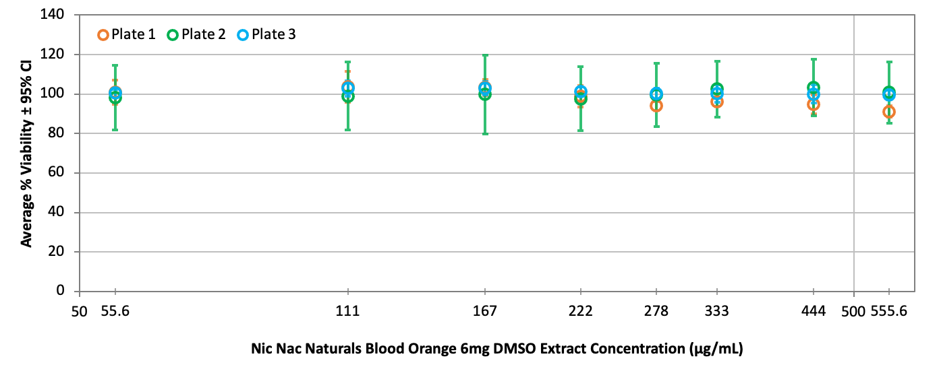
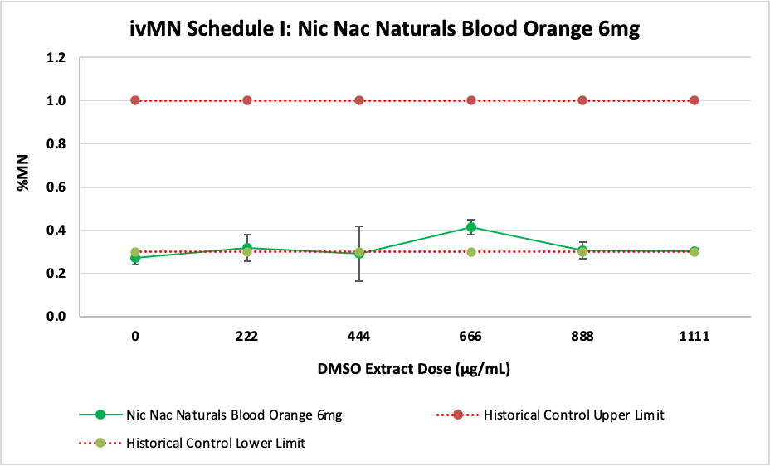
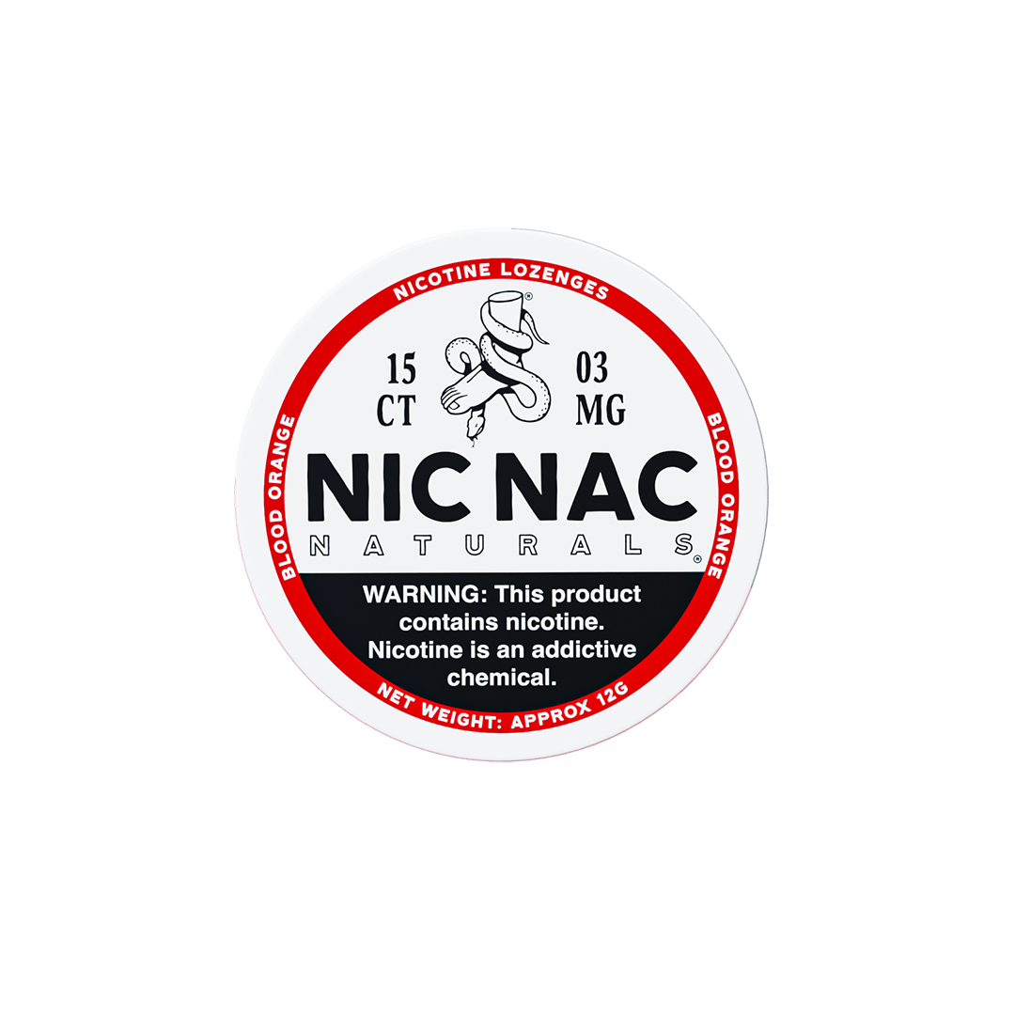
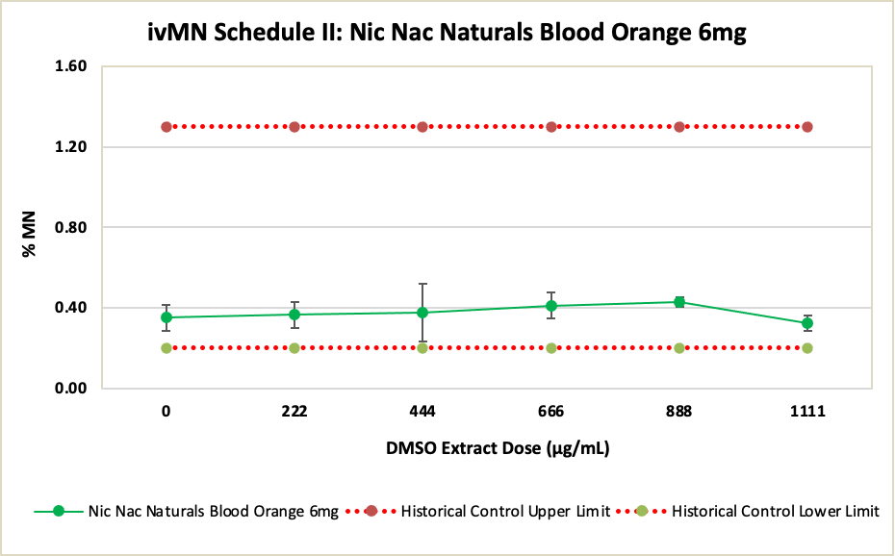
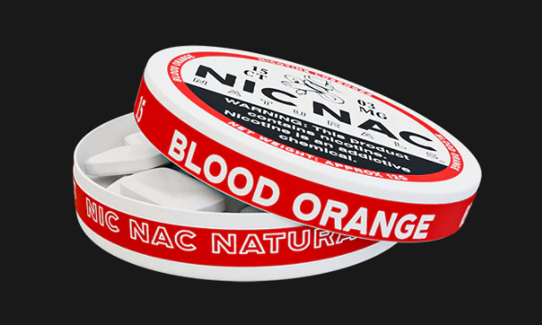
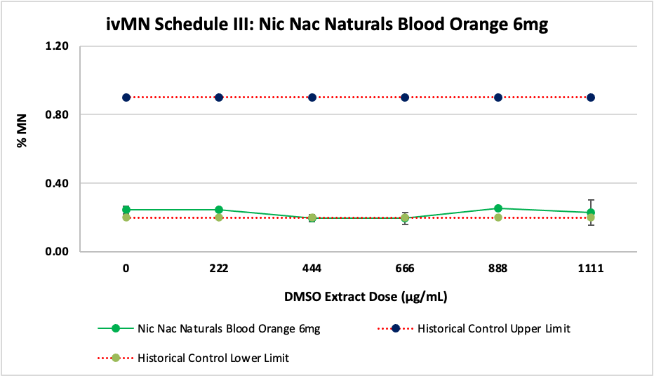
IN VITRO TOXICOLOGICAL ASSESSMENT OF NIC NAC NATURALS ORAL NICOTINE LOZENGE
Manoj Misra, Ed Carmines and Lise Fraissinet
Chemular Inc, Hudson MI, USA
Poster # 14
ABSTRACT
RESULTS
The in vitro toxicological assessment of Modern Oral Nicotine Products (MONP) is an essential part of the US FDA’s premarket tobacco product application (PMTA) process. This assessment was conducted using a battery of well-established regulatory assays, including the Bacterial Reverse Mutation (Ames), in vitro Micronucleus (ivMN) and Neutral Red Uptake (NRU) regulatory assays to assess potential mutagenicity, genotoxicity, and cytotoxicity, respectively.
The Nic Nac Naturals (NNN) lozenges contain synthetic nicotine, xylitol, natural flavors, and binders and are made by mixing all of the ingredients and compressing the lozenge using a tablet press. The use of NNN lozenge products is similar to typical NRT lozenges. The lozenge is placed in the mouth under the lip until fully dissolved. There is no need to spit. The Nic Nac Naturals Blood Orange 6mg nicotine lozenge was extracted with dimethyl sulfoxide (DMSO) and used for toxicological assessment within the time frame of established extract stability by nicotine analysis. Under the experimental conditions and based on the established criteria for evaluation of various assays, no cytotoxicity, mutagenicity, nor genotoxicity was observed for the Nic Nac Naturals Blood Orange 6mg lozenge product.
Cytotoxicity: NRU Test
MUTAGENECITY: AMES TEST
GENOTOXICITY: In Vitro Micronucleus (ivMN) TEST
Revertant Colony Count per Plate with Metabolic Activation (+S9)
ivMN Schedule l results for Nic Nac Naturals Blood Orange 6mg
DMSO Extract Concentration (mg/plate) | TA98 (rev./plate) |  | TA100 (rev./plate) |  | TA102 (rev./plate) |  | TA1535 (rev./plate) |  | TA1537 (rev./plate)
 | Mean | S.D. | Mean | S.D. | Mean | S.D. | Mean | S.D. | Mean | S.D.
0 | 44 | 5 | 162 | 5 | 418 | 8 | 13 | 4 | 8 | 1
0.278 | 51 | 3 | 147 | 9 | 463 | 7 | 15 | 4 | 12 | 4
0.556 | 52 | 6 | 150 | 12 | 347 | 17 | 14 | 2 | 14 | 5
1.111 | 54 | 3 | 169 | 10 | 421 | 24 | 14 | 3 | 15 | 3
2.222 | 46 | 6 | 161 | 5 | 384 | 31 | 18 | 3 | 13 | 6
3.333 | 52 | 8 | 155 | 15 | 357 | 25 | 16 | 4 | 10 | 0
4.444 | 38ᴬ | 4 | 152ᴬ | 9 | 366ᴬ | 31 | 17 | 3 | 8ᴬ | 4
5.556 | 36ᴬ | 10 | 149ᴬ | 6 | 365ᴬ | 51 | 15 | 3 | 11ᴬ | 3
STUDY DESIGN AND METHODS
A= Observed toxicity (thinning of the background lawn, pinpoint colonies, absence of background lawn)
Revertant Colony Count per Plate without Metabolic Activation (-S9)
The testing was conducted at Labstat International, Inc. Kitchener, ON, Canada following OECD and GLP guidelines.
pH: Summary for Nic Nac Naturals Blood Orange 6mg in DMSO Extracts
DMSO Extract Concentration (mg/plate) | TA98 (rev./plate) |  | TA100 (rev./plate) |  | TA102 (rev./plate) |  | TA1535 (rev./plate) |  | TA1537 (rev./plate)
 | Mean | S.D. | Mean | S.D. | Mean | S.D. | Mean | S.D. | Mean | S.D.
0 | 31 | 2 | 141 | 7 | 427 | 28 | 15 | 3 | 11 | 4
0.278 | 26 | 2 | 143 | 9 | 416 | 17 | 15 | 2 | 15 | 5
0.556 | 38 | 5 | 136 | 13 | 395 | 28 | 13 | 3 | 10 | 3
0.833 | 38 | 1 | 140 | 8 | 366 | 37 | 15 | 3 | 11 | 3
1.111 | 32 | 4 | 161 | 5 | 404 | 31 | 16 | 3 | 12 | 4
1.667 | 27 | 2 | 126 | 6 | 420 | 21 | 16 | 4 | 11 | 2
2.222 | 31ᴬ | 4 | 135ᴬ | 2 | 356ᴬ | 8 | 13 | 2 | 11ᴬ | 3
3.333 | 33ᴬ | 5 | 137ᴬ | 9 | 406ᴬ | 40 | 15 | 4 | 17ᴬ | 4
NIC NAC NATURALS ORAL NICOTINE LOZENGE PRODUCT
Description | Extract Dose (µg/mL) | pH | Difference from Vehicle Control
Vehicle Control | 0 | 8.04 | NA
DMSO Extract of Nic Nac Naturals Blood Orange 6mg | 55.6 | 8.14 | 0.10
 | 111 | 8.20 | 0.16
 | 167 | 8.18 | 0.14
 | 222 | 8.13 | 0.09
 | 278 | 8.16 | 0.12
 | 333 | 8.19 | 0.15
 | 444 | 8.28 | 0.24
 | 555.6 | 8.17 | 0.13
ivMN Schedule lI results for Nic Nac Naturals Blood Orange 6mg
NOTP Description | Target Nicotine (mg/lozenge)
Nic Nac Naturals Blood Orange 6mg | 6 mg
A= Observed toxicity (thinning of the background lawn, pinpoint colonies, absence of background lawn)
Summary of Ames assay dose-dependent Mutagenic response in DMSO extracts for Blood Orange 6mg
Osmolarity: Summary for Nic Nac Natural Blood Orange 6mg in DMSO Extracts
Bacterial Strains (+/- S9) | Statistical Summary of Ames assay dose-dependent Mutagenic response in DMSO extracts for Blood Orange 6mg
 | Dunnett's Test Result | 2 or 3 folds Mean Solvent Control | Historical Vehicle Control Range (rev./plate) | Overall Range for the product | Evaluation of Replicate Mutagenic Response
TA98 (+S9) | not significant | 87 | 20 - 50 | 44 - 54 | non-mutagenic
TA100 (+S9) | not significant | 323 | 70 - 200 | 147 - 169 | non-mutagenic
TA102 (+S9) | not significant | 837 | 140 - 480 | 347 - 463 | non-mutagenic
TA1535 (+S9) | not significant | 40 | 5 - 20 | 13 - 18 | non-mutagenic
TA1537 (+S9) | not significant | 23 | 5 - 20 | 8 - 15 | non-mutagenic
TA98 (-S9) | not significant | 63 | 20 - 50 | 26 - 38 | non-mutagenic
TA100 (-S9) | not significant | 283 | 70 - 200 | 126 - 161 | non-mutagenic
TA102 (-S9) | not significant | 853 | 140 - 480 | 366 - 427 | non-mutagenic
TA1535 (-S9) | not significant | 46 | 5 - 20 | 13 - 16 | non-mutagenic
TA1537 (-S9) | not significant | 34 | 5 - 20 | 10 - 15 | non-mutagenic
SAMPLE PREPARATION AND CHARACTERIZATION
Description | Extract Dose (µg/mL) | Osmolarity [mOsm/L] | Difference from Vehicle Control (%)
Vehicle Control | 0 | 379 | NA
DMSO Extract of Nic Nac Naturals Blood Orange 6mg | 55.6 | 372 | -1.8
 | 111 | 382 | 0.8
 | 167 | 382 | 0.8
 | 222 | 373 | -1.6
 | 278 | 372 | -1.8
 | 333 | 371 | -2.1
 | 444 | 372 | -1.8
 | 555.6 | 372 | -1.8
The lozenge was ground and sieved through a 4 mm sieve to ensure a particle size of ≤ 4 mm and extracted with DMSO with the ultrasonic homogenizer at 37°C incubator for 21 hours. The extracts was shaken, filtered, and centrifuged to remove any particulate matter. The sterility of each extract was confirmed by the absence of microbial growth. The nicotine in the extracts was determined by a GC-FID method. Appropriate amounts of the filter sterilized extracts were used for the Ames assay, NRU assay, ivMN assay and chemistry analysis.
ivMN Schedule lII results for Nic Nac Naturals Blood Orange 6mg
IN VITRO TOXICOLOGY ASSAYS
Assay | Official Method
Bacterial Reverse Mutation (Ames) Assay | OECD Number 471
Neutral Red Uptake (NRU) Cytotoxicity Assay | Health Canada T-502
 | OECD Number 129
In Vitro Mammalian Cell Micronucleus (ivMN) Assay | OECD TG487
CONCLUSIONS
REFERENCES
The in vitro toxicity of the DMSO extracts of Nic Nac Naturals Blood Orange 6mg nicotine lozenge product were assessed following OECD and GLP guidelines.
Cytotoxicity (NRU Assay): Nic Nac Naturals Blood Orange 6mg nicotine lozenge product was not considered cytotoxic across the tested concentrations in comparison to vehicle control. No EC50 could be calculated since no dose-dependent cytotoxicity was observed.
Mutagenicity (Ames Assay): The Nic Nac Naturals Blood Orange 6mg nicotine lozenge product was not considered mutagenic in five tester bacterial strains in the absence or presence of metabolic activation across the tested concentrations in comparison to vehicle control.
Genotoxicity (in vitro Micronucleus Assay): The Nic Nac Naturals Blood Orange 6mg nicotine lozenge product was not considered genotoxic across the tested concentrations in comparison to vehicle control under both short-term and long-term conditions of the assay.
Comparatively, significant in vitro cytotoxicity, mutagenicity and genotoxicity was reported in the smoke total particulate matter (TPM) of the Kentucky reference cigarette, 1R6F tested according to OECD test guidelines (Yu et al. 2022).
Genotoxic Evaluation Summary for Nic Nac Naturals Blood Orange 6mg
OECD Guideline for The Testing of Chemicals: In Vitro Mammalian Cell Micronucleus Test, No. TG487, Adopted 29 July 2016.
OECD (2020), Test No. 471: Bacterial Reverse Mutation Test, OECD Guidelines for the Testing of Chemicals, Section 4, OECD Publishing, Paris.
OECD (2010) Test No. 129: Guidance document on using cytotoxicity tests to estimate starting doses for acute oral systematic toxicity tests, Series on Testing and Assessment: Testing for Human Health, OECD Publishing, Paris.
Health Canada Official Method T-502, Third Edition (2017-12-31), Neutral Red Uptake Assay for Mainstream Tobacco Smoke.
Yu F. et al. Preclinical Assessment of Tobacco-Free Nicotine Pouches Demonstrates Reduced In Vitro Toxicity Compared with Tobacco Snus and Combustible Cigarette Smoke. Applied In Vitro Toxicology. Mar 2022. 24-35.
Treatment Schedule | Genotoxicity Analysis of ivMN Assay for Nic Nac Naturals Blood Orange 6mg: DMSO Extract
 | Extract Conc. Range with <60% Cytotoxicity (mg/mL) | Chi-Square p-value | Dunnett's Test Result | Historical Solvent Control Range (% Micronuclei) | Overall %MN Range | Evaluation of Replicate Genotoxic Response
Schedule (i) | 0 - 1.111 | 0.662 | not significant | 0.3 - 1.0 | 0.3 - 0.4 | non-genotoxic
Schedule (ii) | 0 - 1.111 | 0.827 | not significant | 0.2 - 1.3 | 0.3 - 0.4 | non-genotoxic
Schedule (iii) | 0 - 1.111 | 1.000 | not significant | 0.2 - 0.9 | 0.2 - 0.3 | non-genotoxic
78th TSRC Conference 2025, Knoxville, TN, USA

