Slide 1


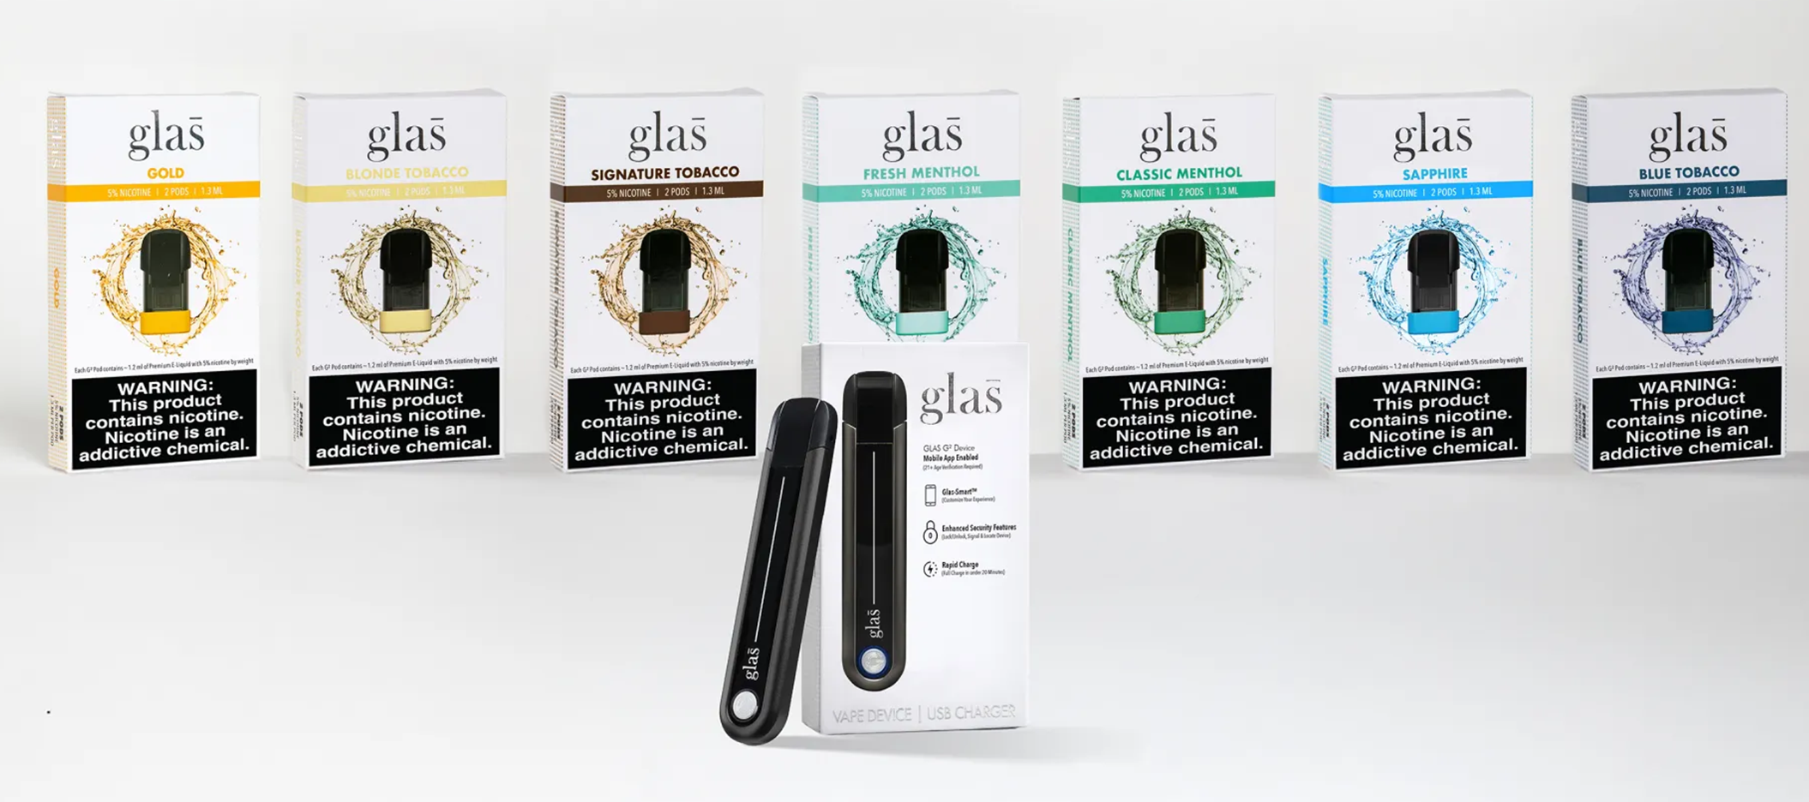
Evaluation of the Excess Lifetime Cancer Risks (ELCR) of a New Age Gated E-Cigarette Ed Carmines and Manoj Misra
Affiliation: Chemular, Inc, Hudson, MI,
Poster #12
Abstract
Methods
Results
Glas has developed a pod-based ENDS device enabled with age-verification technology. The E-Cigarette is locked when purchased and the user is required to register the device and age verify before it can be activated. The E-Liquid in the ENDS contains either 30 or 50 mg/ml of nicotine and is available in tobacco, menthol, or flavored varieties. The excess lifetime cancer risks (ELCR) of the Glas products were calculated taking into consideration of the HPHCs collected under intense vaping conditions and the flavor ingredients in the various products. A conservative approach of 100% flavor transfer was used. Adjusted Inhalation Unit Risk (IUR) values were used for constituents with known carcinogenicity. A default IUR value of 1.5 µg/day was used for Toxicity Tier IV constituents when no carcinogenicity data was available. On average, Glas products’ ELCR is 70% less than the currently FDA authorized Marketing Granted Order ENDS products and less than 0.66% of conventional cigarettes as represented by the Kentucky 1R6F reference cigarette. These analyses indicate that the Glas pod-based age gated E-Cigarettes have an ELCR meaningfully less than currently authorized products and significantly less than conventional cigarettes.
All HPHC testing was conducted at Enthalpy Analytical LLC, Richmond, VA (now McKinney Specialty Labs). The Glas products were vaped under intense puffing regime (110/cc puff, 5 second puff duration, 30 second inter-puff interval). Seven replicates of each constituent were measured. Consumers have the ability to select the energy setting for the device from ECO to Standard. The ECO delivers slightly less energy to the coil than the standard setting. The Standard setting was used for the HPHC analysis. Flavor ingredient quantities were based on confidential disclosures from the suppliers. It was assumed that the flavor ingredients transferred 100% to the vapor. Excess Lifetime Cancer Risks were determined following the methodology outlined in FDA’s July 3, 2024 Memorandum entitled “Calculating Excess Lifetime Cancer Risk in ENDS Premarket Tobacco Product Applications.” For comparison purposes, non-detect values and < Level of Quantification values were assumed to be zero as these values are not available for the 1R6F reference cigarette data. Exposure data was based on ad libitum use data from a human abuse liability study. Daily usage varied from 0.32 to 0.87 ml/day. The worst-case value of 0.87 ml/day was used in all ELCR calculations. Adjusted Inhalation Unit Risks (IURs) were calculated following FDA guidance in the 2024 memorandum. For chemicals with no published IUR, the default of 1.5 ug/day was used. Toxicity classification of the ingredients followed FDA’s approach outlined in its June 3, 2024, memorandum entitled “Genotoxicity Hazard Identification and Carcinogenicity Tiering of Constituents in ENDS Premarket Tobacco Product Applications.”
Table 1. ELCR Calculations for Glas Sapphire flavored product
Data Source | Constituent | Constituent (µg/ml) | Consumption (ml/day) | Consumption (µg/day) | Adjusted IUR | ELCR | ELCR> 1
HPHC | Myosmine | 18.991* | 0.87 | 17.2264 | 1.5 | 11.484 | 11.484
HPHC | Acetaldehyde | 6.5100 | 0.87 | 5.6637 | 122.38 | 0.0463
HPHC | Crotonaldehyde | 0.1000 | 0.87 | 0.0870 | 8.23 | 0.0106
HPHC | Formaldehyde | 3.4400 | 0.87 | 2.9928 | 20.71 | 0.1445
HPHC | Cadmium | 0.0002 | 0.87 | 0.0002 | 0.15 | 0.0013
HPHC | Chromium | 0.0076 | 0.87 | 0.0066 | 0.022 | 0.3009
HPHC | Lead | 0.0016 | 0.87 | 0.0014 | 22.44 | 0.0001
HPHC | Nickel | 0.1070 | 0.87 | 0.0931 | 1.12 | 0.0831
HPHC | Glycidol | 3.361* | 0.87 | 2.9245 | 1.5 | 1.9496 | 1.949
HPHC | Acrylonitrile | 0.0400 | 0.87 | 0.0348 | 3.96 | 0.0088
HPHC | Benzene | 0.0400 | 0.87 | 0.0348 | 34.52 | 0.0010
HPHC | Propylene Oxide | 0.2000 | 0.87 | 0.1740 | 72.77 | 0.0024
Ingredient Disclosure | Confidential Flavor Ingredients | 33.0000 | 0.87 | 28.5400 | 1.5 | 19.026 | 19.026
 |  |  |  |  | ∑ELCR | 33.06 | 32.46
* Myosmine and Glycidol concentrations are estimated based on non-intense vaping results.
Table 2. Combined ELCR for Glas Products
Flavor | HPHC ELCR | Flavor Ingredient ELCR | Combined ELCR | % 1R6F | % MGO ENDS
Sapphire | 13 | 19 | 32 | 0.32% | 27%
Gold | 38 | 0 | 38 | 0.38% | 32%
Fresh Menthol | 21 | 45 | 66 | 0.66% | 56%
Classic Menthol | 12 | 29 | 41 | 0.41% | 35%
Blond Tobacco | 14 | 13 | 27 | 0.27% | 23%
Signature Tobacco | 0 | 0 | 0 | 0.00% | 0%
Blue Tobacco | 27 | 0 | 27 | 0.27% | 23%
The Product and Technology
The Glas products are a pod based vaping system (PBVS). They are rechargeable electronic nicotine delivery system (ENDS) devices. Figure 1 shows a picture of the Glas product and the different flavored pods. The PBVS is enabled with technology designed to prevent underage use and also prevent re-use or use of counterfeit E-Liquid containing pods. The pods are available in tobacco, menthol, and fruit flavors.
Results
Conclusions
Figure 1. Glas Pod Based Vaping System
Table 1 shows the ELCR calculations for the Sapphire flavored product. The flavor ingredients are confidential, and the exposure is shown as the total amount of all Toxicity Tier 4 ingredients. Table 2 shows a summary of the results of all of the different flavored products. The ELCR values ranged from 0 to 66. Signature Tobacco did not have any Tier 4 ingredients and the HPHC values were so low that the ELCR for them was also 0. The Gold and Blue Tobacco products also had no flavor ingredients that were Toxicity Tier 4.
The FDA reported in the June 3, 2024, memorandum that the ELCR for conventional cigarettes as indicated by HPHC data for 1R6F was approximately 10,000. Using this value, it is possible characterize the risks of the Glas products as a % of cigarettes. All of the Glas products had a risk of less than 0.1% of cigarettes indicating very low concern. The FDA also reported in the June 3, 2024, memorandum that the median ELCR for the ENDS MGO marketplace at the time was 118. The Glas products’ ELCR ranged from 0 to 66 indicating that the Glas products are unlikely to raise toxicological concerns regarding cancer risk.
Glas pod-based age gated E-Cigarettes have an ELCR meaningfully less than currently authorized ENDS products and significantly less than conventional cigarettes. The Glas products’ ELCR ranged from 0 to 66 indicating that the Glas products are unlikely to raise toxicological concerns regarding cancer risk.
78th TSRC Conference 2025, Knoxville, TN

