Slide 1
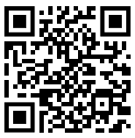

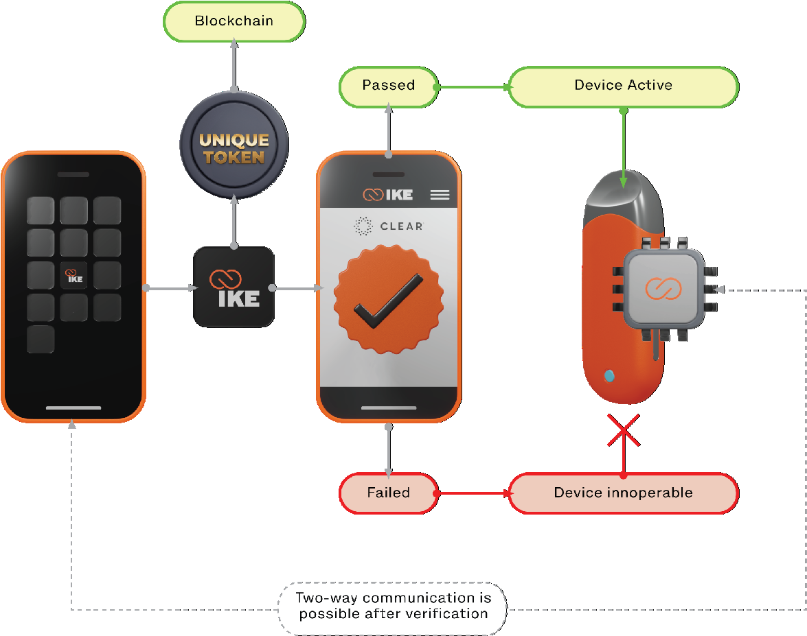
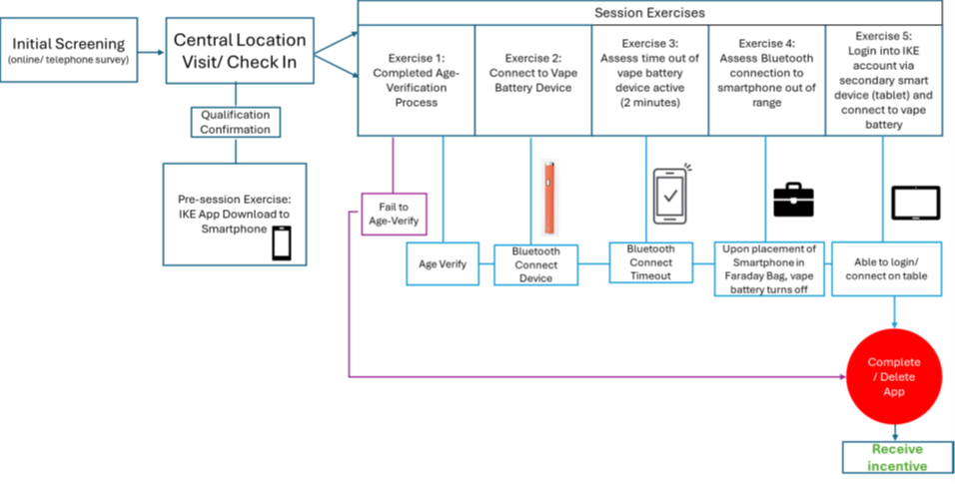
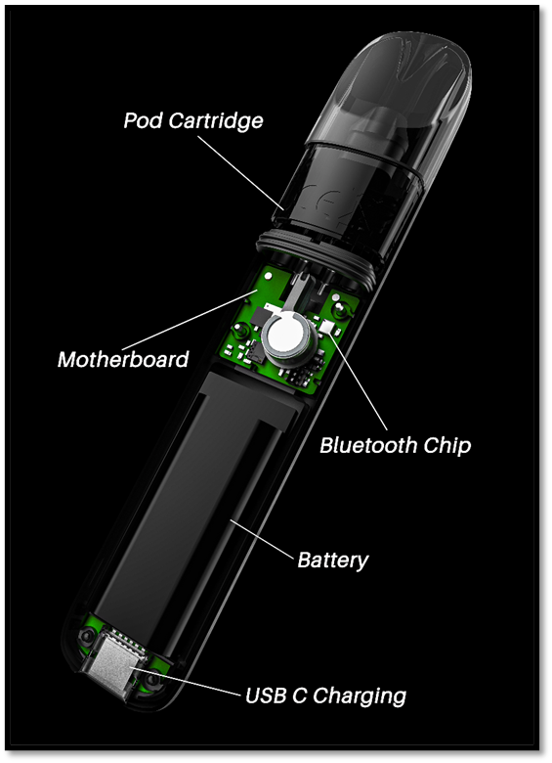
Human Factors Validation and Useability Testing of the IKE ENDS Age Verification System
Ed Carmines¹ , Azure Steele² , Elisabeth Upton³ , Nadelyn Lim⁴ ;
¹ Chemular, Inc, Hudson, MI, USA, ² M/A/R/C Research, High Point, NC, USA, ³ Ispire, Torrance, CA, USA, ⁴ IKE, Tech, Torrance, CA, USA.
Poster #11
Abstract
Key Benefits of Technology
Results
.
A multi-center human factors validation study using the IKE Age Verification System was conducted with 102 participants (51% male, 49% female) aged 18-67 (22% 18-20 years, 18% 21-24 years, 20% 25-44 years, 20% 45-64 years, 20% 65 years or older) who had smartphones and were comfortable using smartphone applications. This study aimed to validate the design and development and to test a smartphone-based application accuracy at age verification, and a system-on-a-chip embedded into a device effectiveness at activating/deactivating the device based on a user’s age. Participants underwent a task-based usability assessment to test the function and effectiveness of the IKE System followed by an Ease-of-Use scale assessment to measure the satisfaction, interface effectiveness, and overall system usability. The study evaluated the IKE System with the intended-to-market user interface and representative users in representative simulated-use environments. All participants that downloaded the IKE application (n=101), were able to accurately age verify, and the device was only activated for those of legal age or older. All (100%) devices were deactivated after 15 minutes of idle time, and after losing Bluetooth signal (out of range). Users were able to re-connect and re-activate their devices. Age, race/ethnicity, and gender did not impact identification or age verification. Participant ranked ease-of-use of the IKE application was 90% Very Easy or Extremely Easy, 8% Somewhat Easy, and 2% Somewhat Easy or Not Easy. User errors were rare (1%, n=102) with simulated use, with only one participant unable to download the application.
The technology uses state of the art encryption technology;
The hardware and software are product agnostic and can be implemented on any electronic device;
Firmware updates are not required; Participant ranked ease-of-use of the IKE application was 90% Very Easy or Extremely Easy
There is no collection of personally identifiable information and therefore no HIPAA concerns; and
The hardware and software are designed to not impact product performance in terms of energy consumption nor nicotine delivery.
A total of 166 individuals were recruited into the study and, of the recruited subjects, 130 came to the sites and 129 were able to download the APP. 102 completed the study (51% male, 49% female (22% 18-20 years, 18% 21-24 years, 20% 25-44 years, 20% 45-64 years, 20% 65 years or older), Both iOS and Android operating systems were tested. Samsung and Apple iPhone models were. 46 different models of smartphones were tested.
Ability to Download/Use the Application:
The Application is available on the Google Play Store and the Apple App Store. One participant (45-64 year old white non-Hispanic male) out of 130 was unable to download the application. All of the remaining subjects were able to use the application.
Under Legal Age Results:
A total of 22 underage individuals (100%) were able to ID verify but were not able to activate the device because they were underage.
Legal Age Results:
A total of 79 Legal Age individuals (100%) were able to ID verify activate the device. Across participants, the vast majority perceived the application as extremely or very easy to use (74% and 17% respectively).
Maximum Idle Time Function:
The device is currently pre-set to turn off after 15 minutes of no use. This ensures that the device will shut down and an unauthorized user cannot surreptitiously use the device. All (100%) of the authorized users’ devices shut down after 15 minutes. All of the authorized users were able to reactivate the device.
Out of Bluetooth Range:
The device is designed to shut down when the device is out of Bluetooth range from the smartphone. This ensures that an unauthorized user cannot surreptitiously use the device by removing it from the general vicinity of the authorized users’ smartphone. All (100%) of the vape devices disconnected from the smartphone when their Bluetooth connection was blocked. All of the authorized users were able to reactivate the device.
Secondary Device:
The application is designed to work on more than one device, but only one device at a time. This allows users to control the device from a second smartphone, tablet, or computer. All (100%) of the authorized users were able to connect a secondary tablet to the vape device shutting down their access from their smartphone.
Study Objectives
Establish the ability of individuals to download/use the application
Confirm under LA can’t use the Vape device
Confirm that those 21 years of age or older can activate the Vape device
Confirm the Maximum Idle Time function works
Confirm the Out of Bluetooth Range function works
Confirm the user can login on a secondary device
Methods
IKE Technology Solution
The figure below shows an overview of the study flow. Distinct user populations were selected for testing:
18-20 year olds – young adults who will not be able to age-verify as LA
21-24 year olds – young adults who are of A and may or may not age-verify due not possessing an up to date form of valid ID or due to the biometric parameters set in the smartphone application,
25-44 year olds – adults who are of LA and who are familiar with smartphones and are expected to be easily able to complete the process of downloading the application and verifying age
45-64 year olds – adults who are of LA and who use a smartphones but may have some difficulty completing the process
65 year olds and above - adults who are of LA and who use a smartphone but may have difficulty completing the process
The IKE technology solution uses the blockchain technology in two ways. In the first, blockchain information is imbedded in the Bluetooth chip such that every chip becomes unique and identifiable. This ensures the device’s authenticity through the decentralized and immutable nature of blockchain technology as well makes it easy to validate, ensuring it is genuine and has not been tampered with. The second is imbedding blockchain information in the smartphone software such that the information cannot be copied and re-used. That is, the e-cigarette will only respond to unique information from the smartphone. In addition to these, state of the art cryptography features the IKE solution also offers a layered set of defenses against deep fakes such as presentation and injection attacks, including fraud detection, liveness detection, image inspection, screen detection, metadata detection, and more.
IKE System Using Blockchain Cryptographic Security
Rendition of E-cigarette
Study Flow Overview
Conclusion
The Ike system was 100% effective in preventing underage and allowing Legal Age individuals to activate the ENDS device. Age, race/ethnicity, and gender did not impact identification or age verification. As designed, the ENDS device shut off after 15 minutes of inactivity and also when out of Bluetooth range. The users could use more than one smart device to control the ENDS. 90% of the participants ranked ease-of-use to be Very Easy or Extremely Easy. Senior Citizens were able to download the application and activate the ENDS.
78th TSRC Conference 2025, Knoxville, TN, USA

