Slide 1


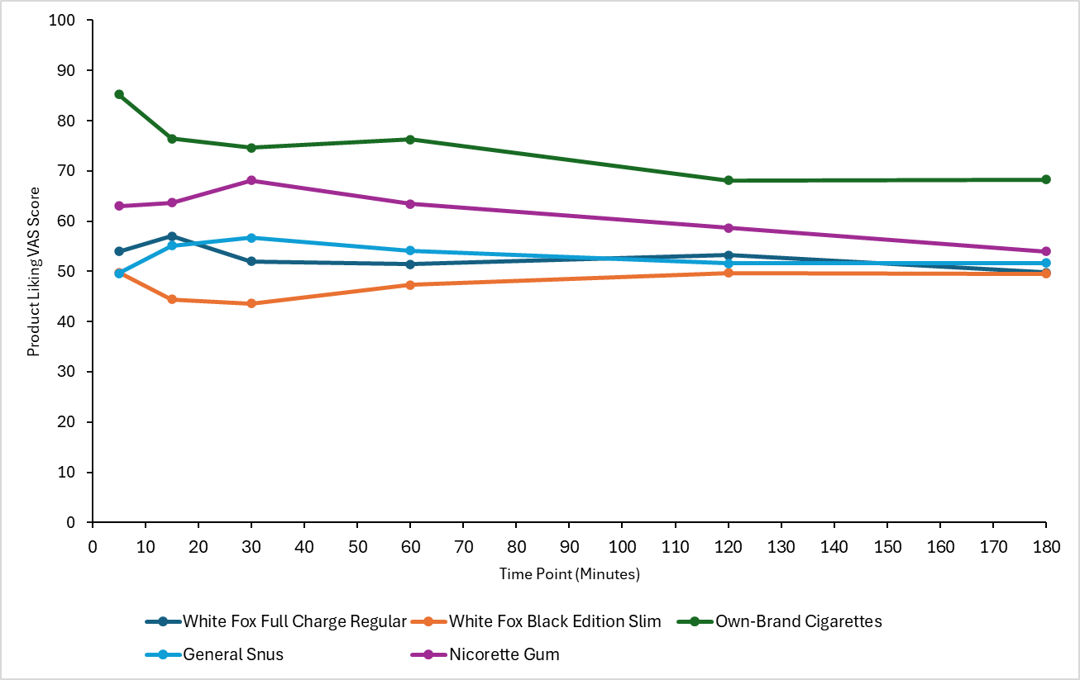
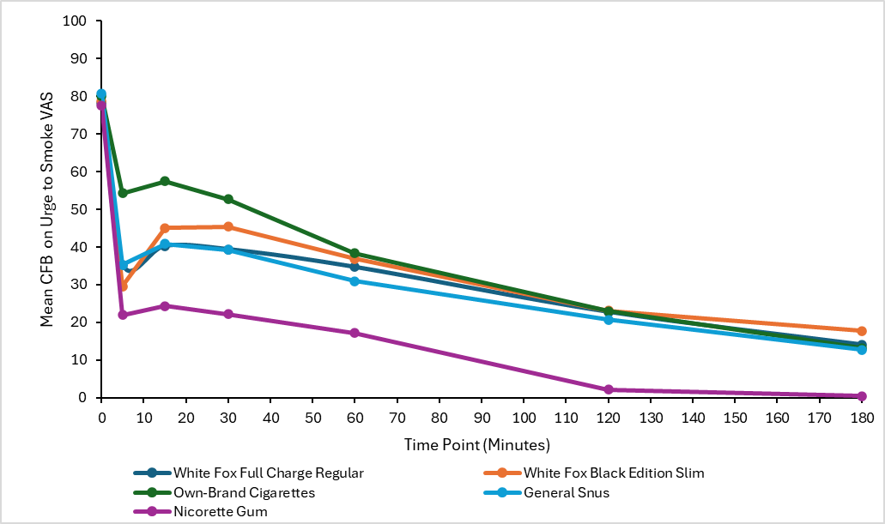
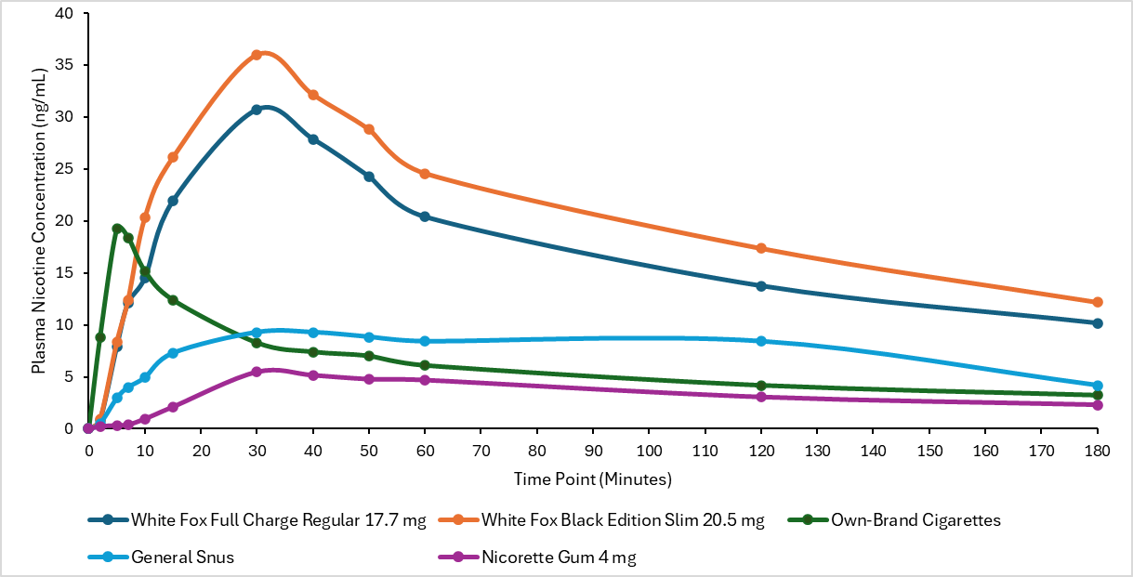
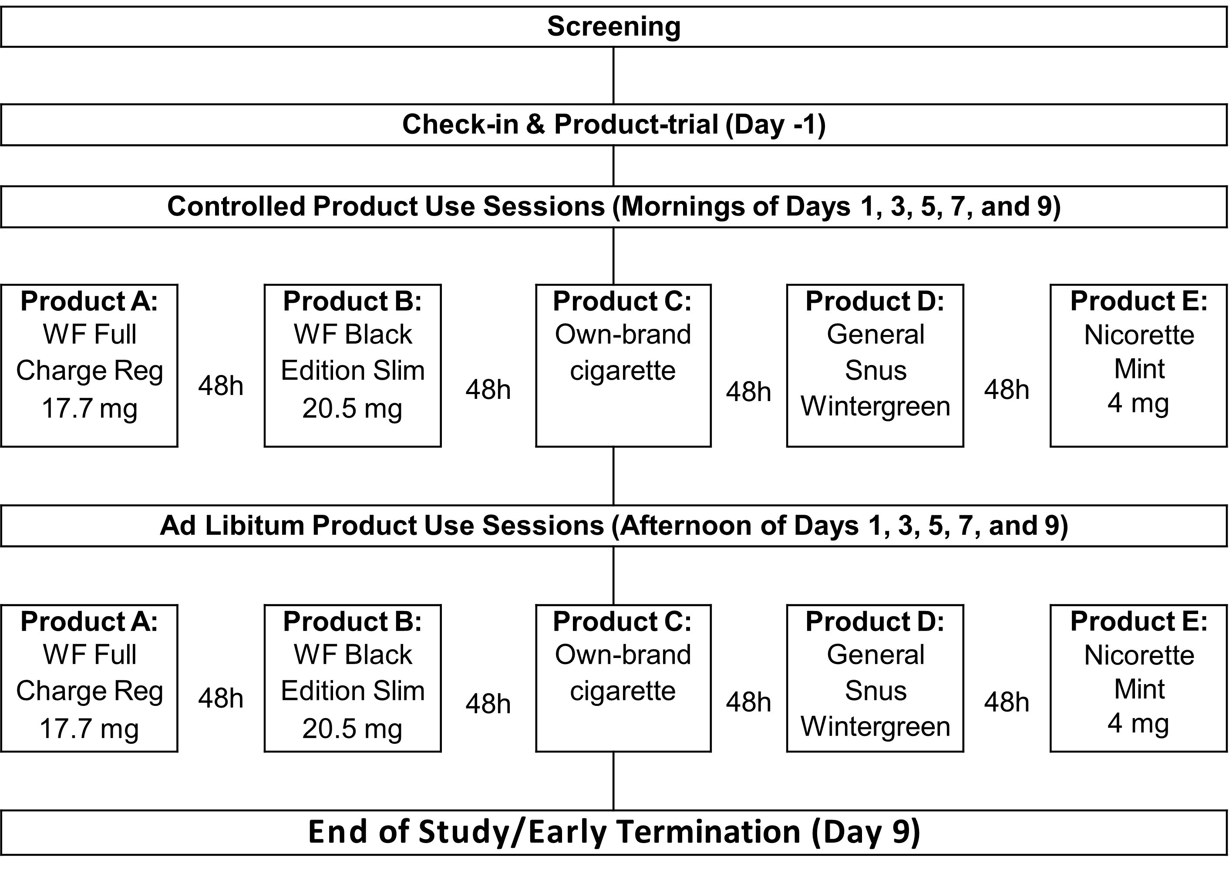

Evaluation of the Abuse Liability of White Fox Nicotine Pouch Products Naama Levy-Cooperman¹, Matthew McMurray², Ed Carmines²
¹Altreos Research Partners, Inc. Toronto, ON, Canada ²Chemular Inc, Hudson MI, USA
Poster # 102
Abstract
Results
Results
Swedish Smokeless manufactures the White Fox brand of nicotine products. These are oral pouches containing synthetic nicotine intended for adult tobacco consumers interested in nicotine satisfaction. This study evaluated the abuse liability of 2 White Fox pouch products compared with own-brand cigarettes, General Snus®, and Nicorette® gum in smokers who had experience using smokeless tobacco. This was a randomized, open-label 5-way crossover study that measured nicotine plasma concentrations, subjective effects (including Product Liking and Urge to Smoke) under controlled-use conditions, and product use behaviors under ad libitum-use conditions. All of the oral products were liked less and suppressed urge to smoke less than own-brand cigarettes (p<0.0001). In general, White Fox Pouch Products reduced the urge to smoke and were liked more than Nicorette gum (p<0.005) but did not differ from General Snus. Nicotine plasma concentrations peaked (T_{max}) at ~7 minutes following initiation of own-brand cigarettes, with a mean maximum concentration (C_{max}) of 21 ng/mL. T_{max} occurred later and C_{max} was higher following use of White Fox Pouch Products (C_{max} of 32-38 ng/mL; T_{max} of 34 minutes). Nicotine absorption from General Snus pouch and Nicorette gum products was slower compared with White Fox Pouch Products (T_{max} of 40 minutes) and C_{max} values were lower at 11 and 6 ng/mL, respectively. When given the choice (Ad Libitum over 4 hours), subjects chose to smoke a mean of 5 own-brand cigarettes, use 3 General Snus, chew 3 Nicorette gum, and use 1-2 White Fox Pouch Products. Despite being used less relative to other products, C_{max} values at the end of Ad Libitum Use were highest for White Fox Pouch Products (~27 ng/mL vs. 22 ng/mL for OBC), suggesting that subjects may have self-titrated. Results suggest that White Fox Pouch Products have lower abuse liability compared with own-brand cigarettes, similar abuse liability compared with General Snus and greater abuse liability compared with Nicorette gum.
Demographics:
A total of 36 participants were randomized and 25 (96.2%) completed the study. The subjects ranged in age from 25 to 64 years, with a mean age of 44.1 years. Most subjects were male (76.9%), white (73.1%), and not Hispanic or Latino (100.0%). The subjects reported smoking 16.3 cigarettes per day for a mean duration of 27.0 years.
Controlled–Use Pharmacokinetics:
Baseline adjusted plasma nicotine concentrations over time for each product are presented in Figure 1.
Own-brand cigarette nicotine time to C_{max} (T_{max}) was 7 minutes with a C_{max} of 18.7 ng/mL. The White Fox products peaked later, with a T_{max} of 34 minutes and peak concentrations were 32.9 and 38.2 ng/mL for Full Charge Regular and Black Edition Slim, respectively. General Snus and Nicorette gum reached a peak nicotine concentration of 10.9 and 6.4 ng/mL at 40 minutes post-use (Table 1).
Mean AUC for own-brand cigarettes was 1133 ng/mL, 1211 ng/mL for General Snus, and 620 ng/mL for Nicorette gum, while the overall exposure for the White Fox was higher at 3138 ng/mL and 3809 for Full Charge and Black Edition, respectively.
Figure 3a and 3b: Controlled Use Pharmacodynamic Effects Over Time
Figure 3a presents mean Product Liking VAS scores over time, participants were asked “At this moment, my liking for this product is,” where scores ranged from 0 (strong disliking) to 100 (strong liking), with 50 (neither like nor dislike) as the neutral point. There was no pre-use measure for this scale as it referred specifically to product effects. Figure 3b presents the reduction in score between pre-use and post-use (change from baseline [CFB]) for the Urge to Smoke VAS, participants were asked “At this moment, I have an urge to smoke a cigarette” ,” where scores ranged from 0 (not at all) to 100 (extremely).
Figure 2: Controlled Use Baseline Adjusted Plasma Nicotine Concentrations
Ad Libitum Product Use Behavior and Pharmacokinetics:
Product use behaviors during the 4-hour ad libitum use session and nicotine plasma concentrations measured at the end of the ad libitum use session are presented in Table 2.
When given the choice (Ad Libitum use), participants used between 1 and 2 White Fox pouch products, smoked an average of 5 own-brand cigarettes, used approximately 3 General Snus pouches and chewed approximately 3 pieces of Nicorette gum in the 4-hour session.
Plasma concentrations at the end of the 4-hour ad libitum use session were highest for the two White Fox products followed by own-brand cigarettes. Consistent with results for the Controlled Product Use Session, General Snus and Nicorette gum were associated with lower nicotine concentrations.
Background
Swedish Smokeless modern oral nicotine pouches were developed as an alternative to smokeless tobacco products and cigarettes. The product contains synthetic nicotine and is intended to emulate pharmacokinetic (PK) aspects of traditional oral nicotine products.
The products are intended to be placed in the mouth between the cheek and gum for 30 minutes.
The White Fox Full Charge Regular product weighs 1000 mg measuring 18 x 32 mm and contains 17.7 mg/pouch of nicotine. The Black Edition Slim product weighs 750 mg measuring 14 x 32 mm and contains 20.5 mg of nicotine per pouch.
Table 2: Ad Libitum Use- Product Use Behavior & Nicotine Plasma Concentrations
Objective and Methods
 | White Fox Full Charge Regular 17.5 mg | White Fox Black Edition Slim 20.5 mg | Own-Brand Cigarettes | General Snus Wintergreen | Nicorette Gum Mint 4 mg
Number of Products Used
Mean (SD) | 1.9 (0.78) | 1.6 (0.68) | 4.9 (2.08) | 2.6 (1.20) | 2.8 (1.50)
Median | 2.0 | 1.5 | 4.0 | 3.0 | 3.0
Range | 1, 3 | 1, 3 | 1, 9 | 1, 5 | 1, 7
Nicotine Plasma Concentration at 4 Hours Post-Use (ng/mL)
Mean (SD) | 28.93 (21.52) | 26.04 (18.25) | 22.37 (11.01) | 14.49 (12.70) | 10.22 (7.31)
Median (Min, Max) | 28.5 (1.89, 66.1) | 24.7 (1.93, 64.4) | 21.9 (5.11, 45.8) | 9.58 (0.87, 42.6) | 9.43 (0.36, 30.8)
The objective of this study was to evaluate the abuse liability of 2 White Fox nicotine pouch products (Full Charge Regular and Black Edition Slim) relative to own-brand cigarettes, General Snus, and Nicorette gum, as measured by plasma nicotine concentrations, subjective effects measures, including product liking, and product use behaviors under controlled and ad libitum use conditions.
This study was a randomized, open-label, 5-way crossover design in healthy adult male and female smokers who had previous experience using smokeless tobacco. The study included a Screening Phase and an Assessment Phase.
The Assessment Phase included a Product Trial Session on Day -1 and Product Use Sessions, which consisted of morning Controlled Product Use Sessions (i.e., 30 minutes of use for pouches and gum and 10 puffs of own –brand cigarettes) and afternoon Ad Libitum Use sessions. Subjective measures and blood samples were collected prior to use and at multiple timepoints after product use. Figure 1 shows the study design.
Table 1: Controlled Use Nicotine Pharmacokinetic Parameters
 | White Fox Full Charge Regular 17.7 mg | White Fox Black Edition Slim 20.5 mg | Own-Brand Cigarettes | General Snus Wintergreen | Nicorette Gum Mint 4 mg
C_{max} (ng/mL)
Mean (SD) | 32.86 (10.38) | 38.23 (13.59) | 20.65 (13.77) | 10.88 (3.70) | 6.43 (3.82)
Median (Min, Max) | 34.8 (11.2, 48.2) | 36.5 (20.6, 78.8) | 18.1 (3.33, 48.2) | 10.3 (5.48, 22) | 6.3 (1.19, 15.6)
T_{max} (minutes)
Median (Min, Max) | 34.0 (15, 50) | 34.0 (10, 63) | 7.0 (2, 50) | 40.0 (7, 127) | 40.0 (7, 123)
AUC_{0-t} (ng/mL/min)
Mean (SD) | 3138.1 (926.3) | 3809.2 (1001.6) | 1133.3 (568.7) | 1210.7 (471.6) | 620.4 (341.9)
Median (Min, Max) | 3262.8 (1265.6, 4764.9) | 3949.1 (2122.0, 6099.9) | 1256.1 (318.9, 2339.7) | 1121.9 (655.3, 3038.7) | 604.7 (134.6, 1431.2)
Figure 1: Study Design
Conclusions
Under single controlled product use conditions, White Fox Pouch Products were associated with lower ratings of product liking and reduced ratings of urge to smoke compared with own-brand cigarette, though White Fox products had statistically greater peak and overall exposures to nicotine. Comparisons between the White Fox Pouch Products and General Snus pouch on measures of product liking and urge to smoke revealed few differences, while comparisons with Nicorette gum suggested similar product liking but greater reductions in the urge to smoke with the pouch products.
Under ad libitum use conditions, participants actively chose to use fewer White Fox pouches relative to the comparators; however, at the end of the session, nicotine exposure was highest for the White Fox Pouch Products, suggesting that subjects may have self-titrated.
Overall, the results of this study suggest that White Fox Pouch Products have lower abuse liability compared with own-brand cigarette, similar abuse liability compared with General Snus pouch and greater abuse liability compared with Nicorette gum.
Controlled-Use Pharmacodynamics:
Mean Product Liking and mean Urge to Smoke change from baseline values over time are presented in Figure 3. Mean peak scores (E_{max}) on the Product Liking VAS and mean CFB_{max} scores on Urge to Smoke VAS for both White Fox pouch products were significantly lower compared with own-brand cigarette (p<0.0001), indicating that the 2 White Fox products were liked less than and reduced the urge to smoke less than smoking a cigarette.
In general, White Fox products did not differ from General Snus or Nicorette gum on the Product Liking VAS. For Urge to Smoke VAS, mean CFB_{max} values for both White Fox pouch products were significantly higher compared with Nicorette gum (p<0.05 for all), but did not statistically differ from General Snus. These findings suggest that, despite being equally liked, the White Fox pouch products reduced the urge to smoke more than Nicorette gum but similarly to General Snus.
78th TSRC Conference 2025, Knoxville, TN USA

